Slide 1
20 standard MR scans with validated ratings on several white matter rating scales
Authors: Prof. Joanna Wardlaw & Dr. Karen Ferguson
University of Edinburgh
Guide prepared by J Wardlaw, K Ferguson, University of Edinburgh
All images copyright J Wardlaw, University of Edinburgh

Slide 2
Standard scans for white matter hyperintensity rating
The following 20 slides show standard slices from MRI scans which have been chosen to represent a wide range of age-related white matter abnormalities. The slides are numbered in ascending order, from few to many white matter lesions.
Each case has been rated using three commonly-used scales, by two experts. The experts read the scans independently, discussed any differences and agreed a final standard rating for each case.
Before reviewing the slides, you may want to remind yourself of the original descriptions of the three white matter lesion rating scales used. You can also use these scans to “recalibrate” yourself white rating scans, e.g. for research purposes.
Longstreth et al. Clinical correlates of white matter findings on cranial magnetic
resonance imaging of 3301 elderly people. The Cardiovascular Health Study. Stroke 1996;27:1274–1282
Fazekas et al. MR signal abnormalities at 1.5T in Alzheimer’s disease and normal aging. AJNR 1987:8:421–426
Fazekas et al. Pathological correlates of incidental MRI white matter signal hyperintensities. Neurology 1993; 43:1683-1689
Wahlund et al. A new rating scale for age-related white matter changes applicable to MRI and CT. Stroke 2001;321318–1322
On the next slide is an example of the standard images shown on each slide and how they should be used.
In order to practice and develop you own white matter lesion rating skills, please download the rating form and complete the ratings for each slide. Please try to rate the scans first, and then click on the “show rating” button to see what the experts thought. Most of the slides do not have any auditory accompaniment, so please just work through them quietly! There are some test cases at the end.
Guide prepared by J Wardlaw, K Ferguson, University of Edinburgh
All images copyright J Wardlaw, University of Edinburgh

Slide 3
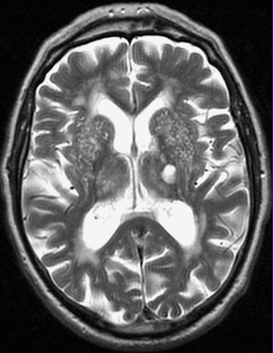
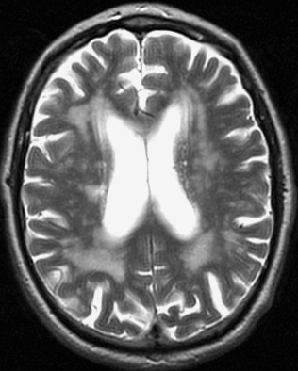
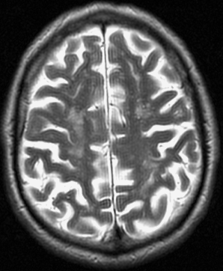
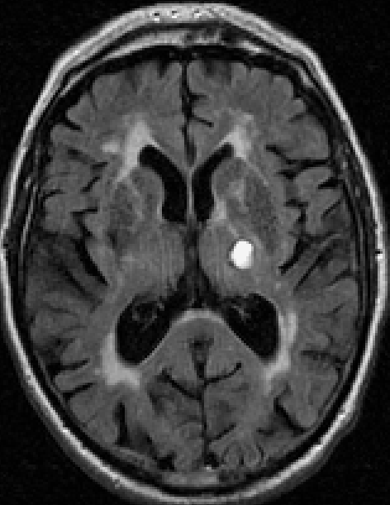
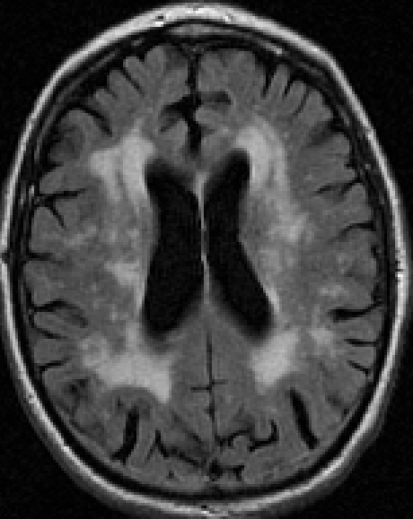
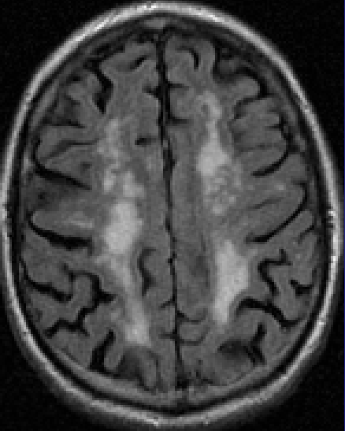
Example:
There are two rows of images in each slide, each showing 3 standard slices, from inferior to superior. The T2-weighted images are on the top row with the FLAIR images below.
Therefore each example is arranged thus:
T2 inferior | T2 medial | T2 superior
FLAIR inferior | FLAIR medial | FLAIR superior
Guide prepared by J Wardlaw, K Ferguson, University of Edinburgh
All images copyright J Wardlaw, University of Edinburgh

Slide 4
Instruction
The T2-weighted images are good for anatomical detail and enlarged perivascular spaces, (circled in right basal ganglia, top right image). The FLAIR images are good for the white matter lesions. In the Fazekas scale, white matter lesions are divided into periventricular (PVH) and deep white matter lesions (DWMH).
You should concentrate mainly on the FLAIR images (bottom row) to rate white matter lesions, as none of the three white matter rating scales include perivascular spaces.
Note that some of the cases have also have a focal lesion, which are pointed out (see arrows, above). Focal lesions should be ignored for the purposes of rating white matter lesions.
The consensus expert ratings for each scale are shown below the images on the second of each pair of slides.
Guide prepared by J Wardlaw, K Ferguson, University of Edinburgh
All images copyright J Wardlaw, University of Edinburgh

Slide 5
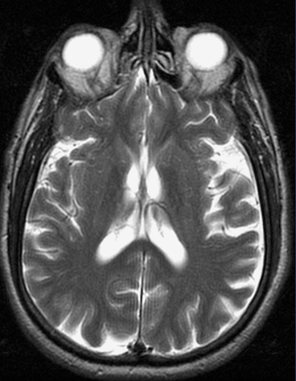
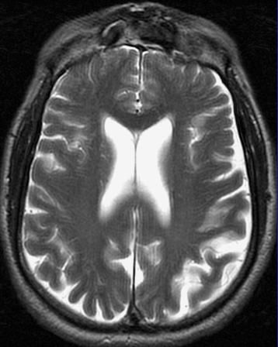
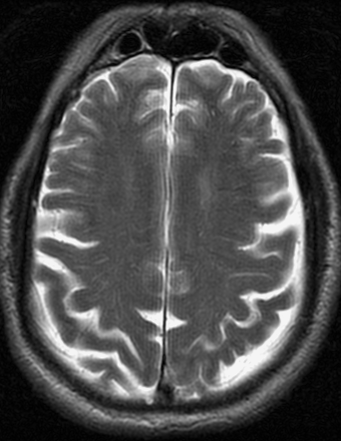
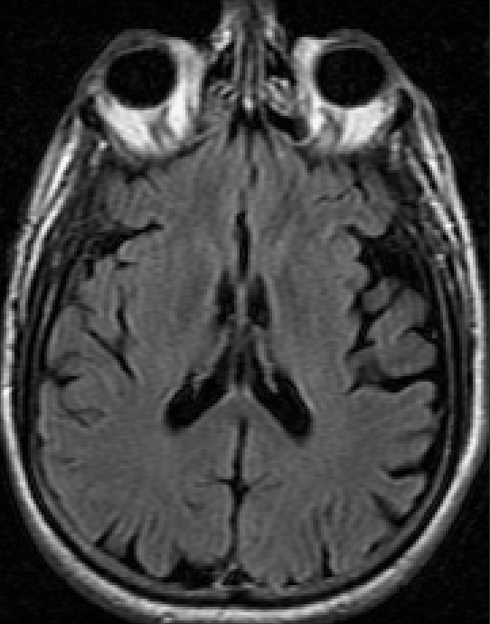
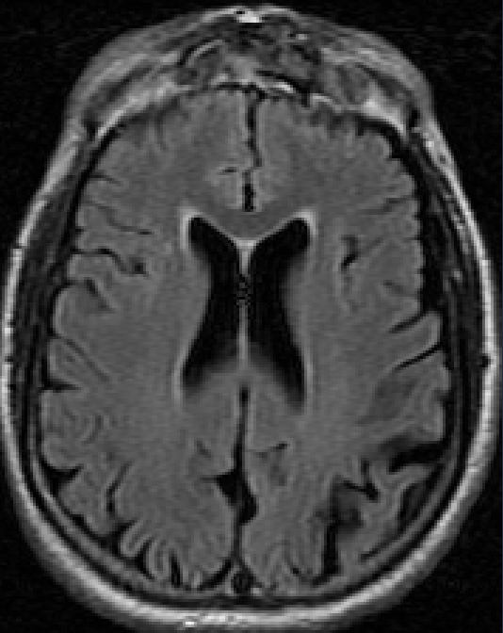
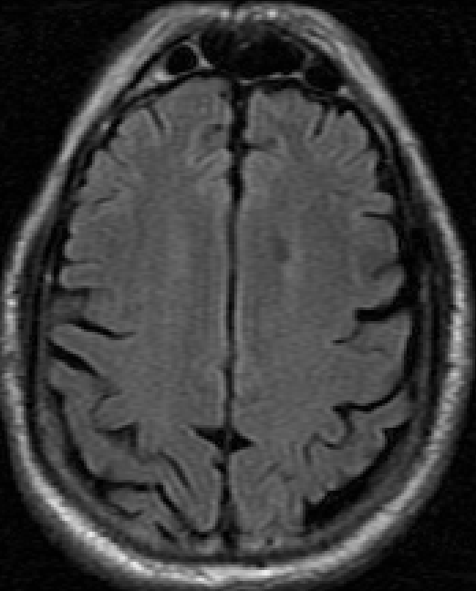
1
Ratings: Fazekas
Longstreth
Wahlund
Comments:
Guide prepared by J Wardlaw, K Ferguson, University of Edinburgh
All images copyright J Wardlaw, University of Edinburgh

Slide 6
1
Ratings: Fazekas PVH 1 / DWMH 0
Longstreth 1
Wahlund 1
Comments: This slide demonstrates the lowest level of white matter lesions.
Guide prepared by J Wardlaw, K Ferguson, University of Edinburgh
All images copyright J Wardlaw, University of Edinburgh
Notes:
6

Slide 7
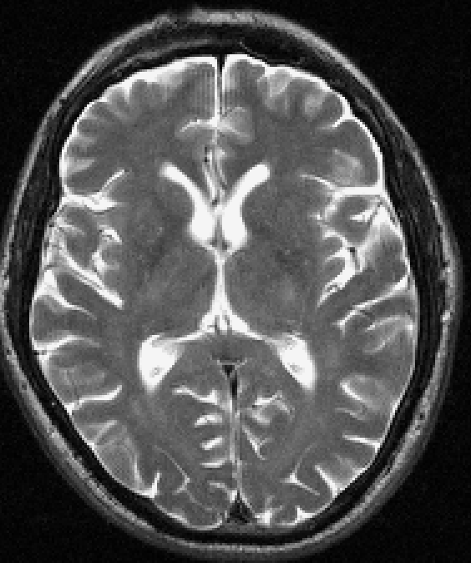
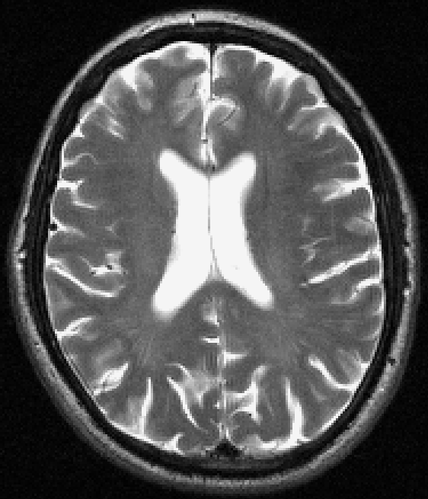
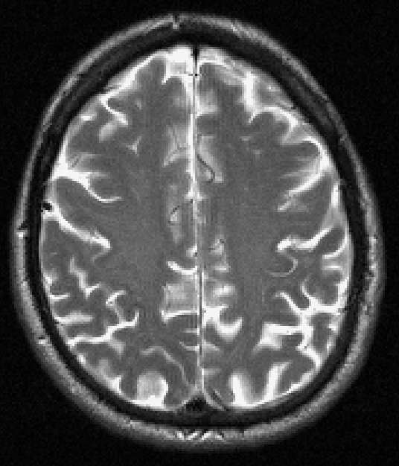
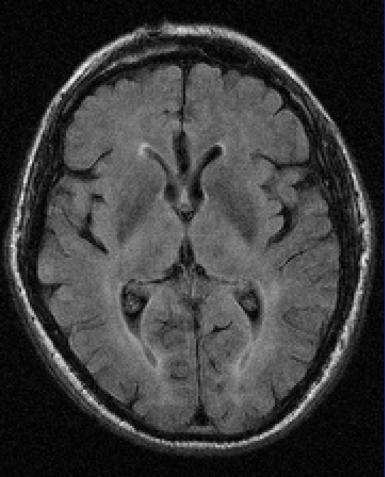
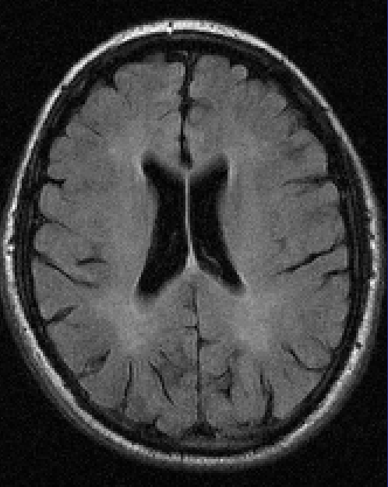
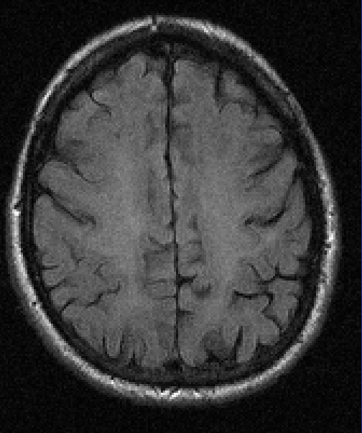
2
Ratings: Fazekas
Longstreth
Wahlund
Guide prepared by J Wardlaw, K Ferguson, University of Edinburgh
All images copyright J Wardlaw, University of Edinburgh

Slide 8
2
Ratings: Fazekas PVH 1 / DWMH 1
Longstreth 1
Wahlund 2
Guide prepared by J Wardlaw, K Ferguson, University of Edinburgh
All images copyright J Wardlaw, University of Edinburgh
Notes:
8

Slide 9
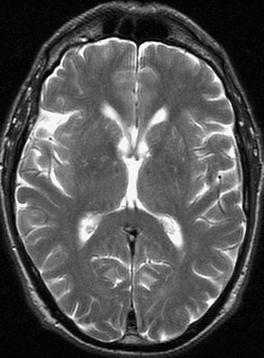
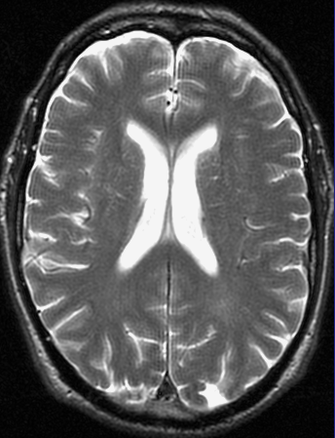
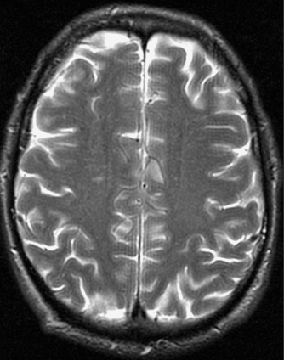
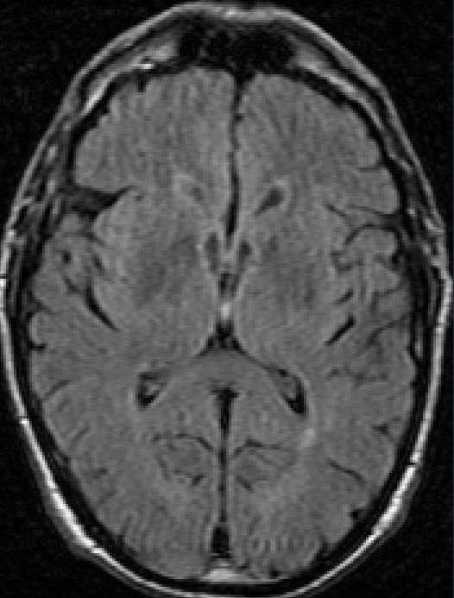
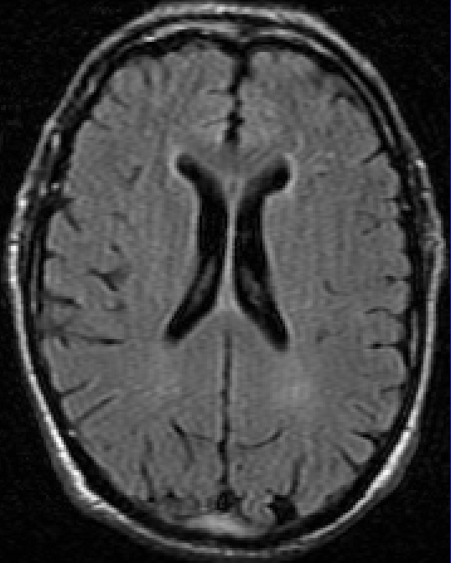
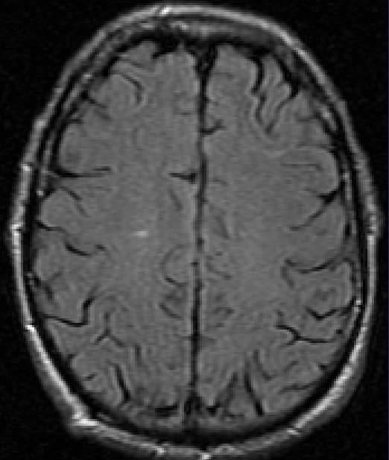
3
Ratings: Fazekas
Longstreth
Wahlund
Guide prepared by J Wardlaw, K Ferguson, University of Edinburgh
All images copyright J Wardlaw, University of Edinburgh

Slide 10
3
Ratings: Fazekas PVH 1 / DWMH 1
Longstreth 1
Wahlund 1
Guide prepared by J Wardlaw, K Ferguson, University of Edinburgh
All images copyright J Wardlaw, University of Edinburgh
Notes:
10

Slide 11
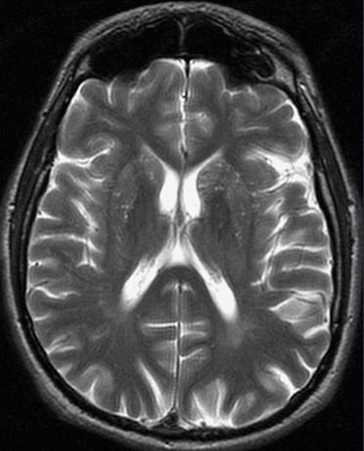
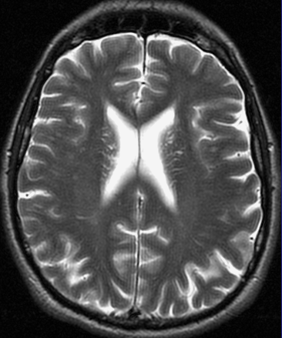
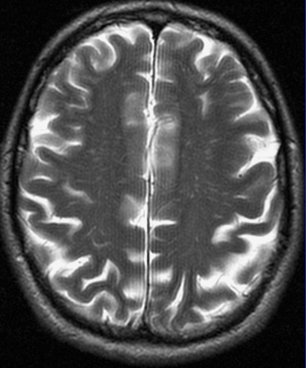
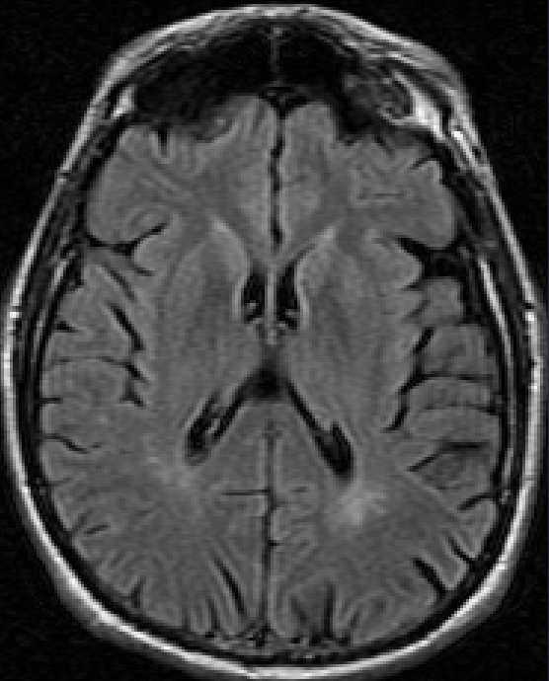
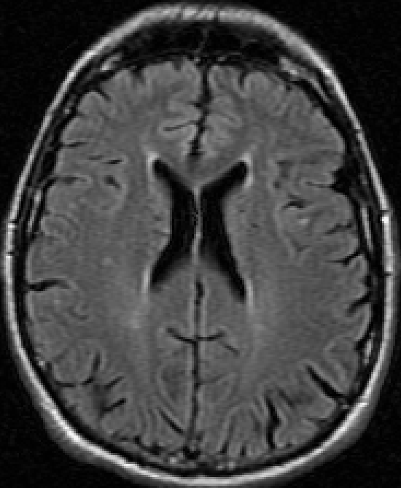
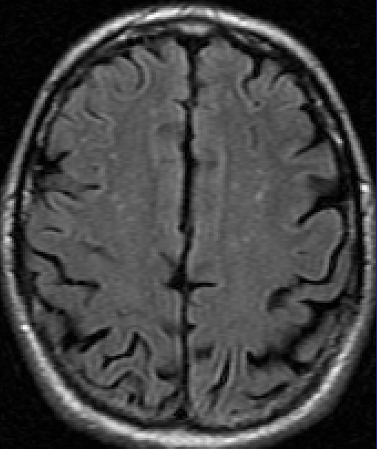
4
Ratings: Fazekas
Longstreth
Wahlund
Guide prepared by J Wardlaw, K Ferguson, University of Edinburgh
All images copyright J Wardlaw, University of Edinburgh

Slide 12
4
Ratings: Fazekas PVH 1 / DWMH 1
Longstreth 1
Wahlund 1.5
Guide prepared by J Wardlaw, K Ferguson, University of Edinburgh
All images copyright J Wardlaw, University of Edinburgh
Notes:
12

Slide 13
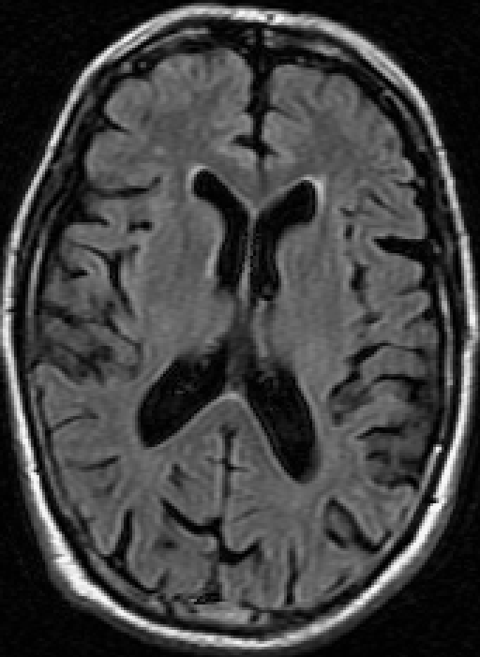
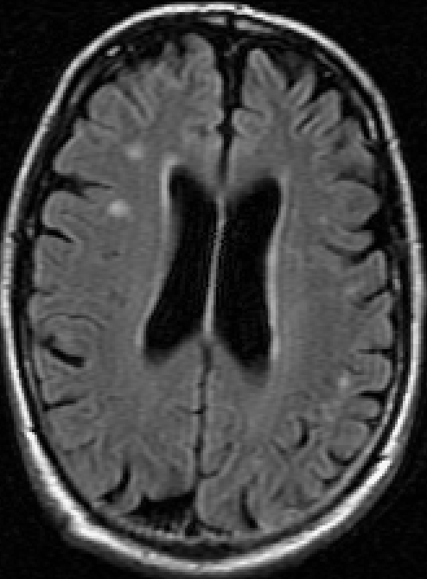
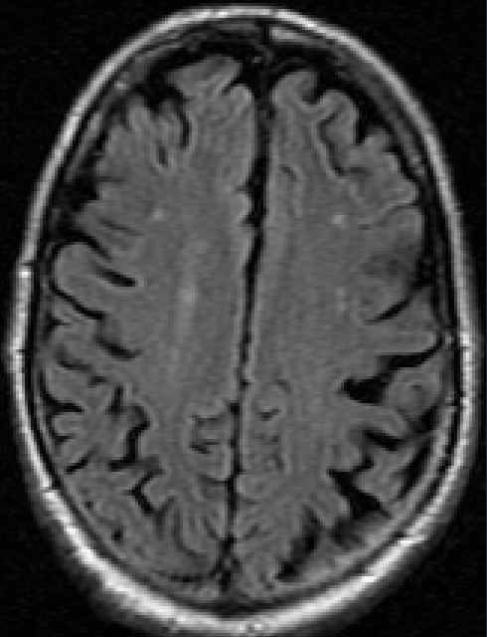
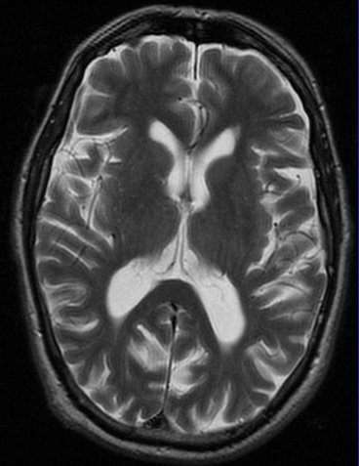
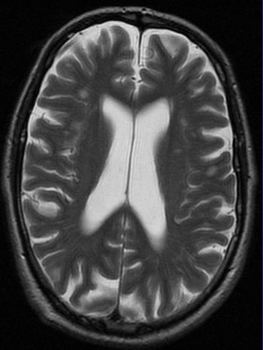
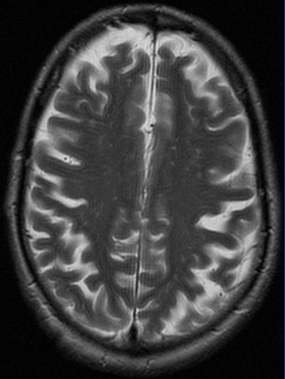
5
Ratings: Fazekas
Longstreth
Wahlund
Guide prepared by J Wardlaw, K Ferguson, University of Edinburgh
All images copyright J Wardlaw, University of Edinburgh

Slide 14
5
Ratings: Fazekas PVH 1 / DWMH 1
Longstreth 1
Wahlund 1.5
Guide prepared by J Wardlaw, K Ferguson, University of Edinburgh
All images copyright J Wardlaw, University of Edinburgh
Notes:
14

Slide 15
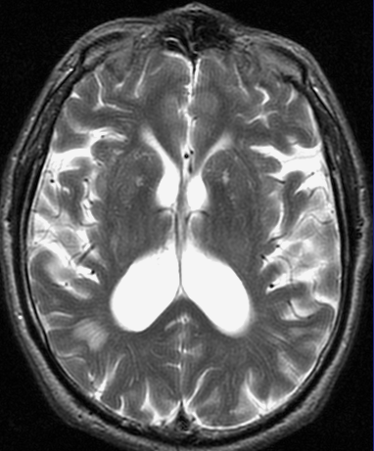
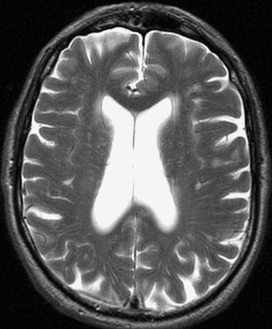
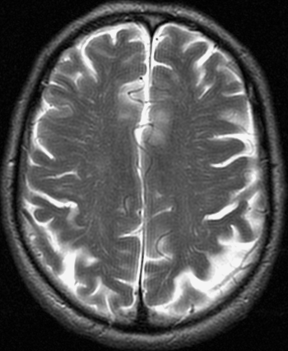
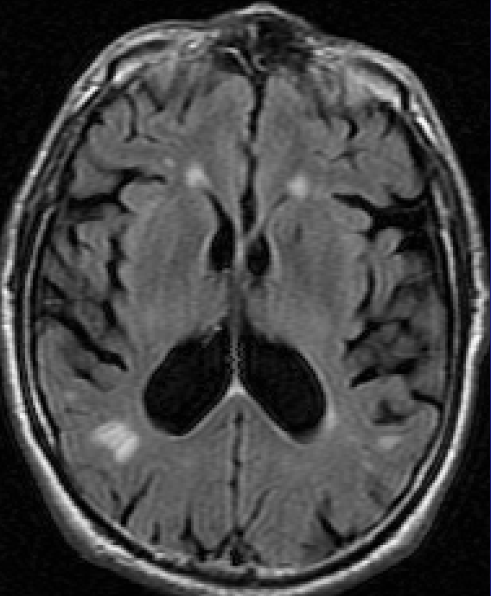
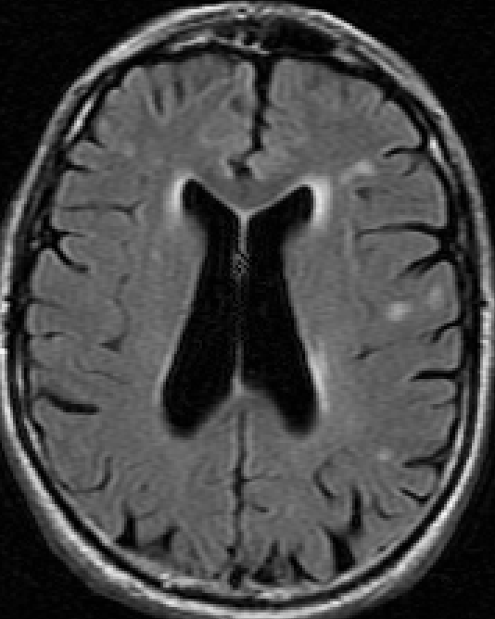
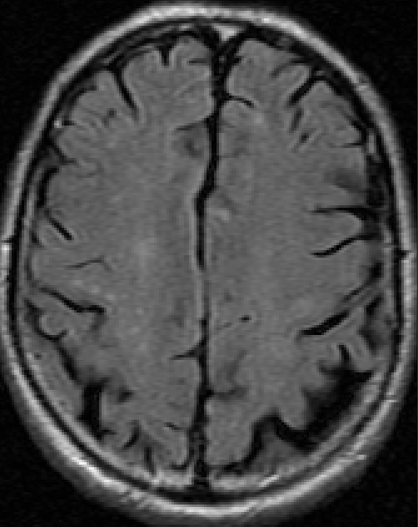
6
Ratings: Fazekas
Longstreth
Wahlund
Guide prepared by J Wardlaw, K Ferguson, University of Edinburgh
All images copyright J Wardlaw, University of Edinburgh

Slide 16
6
Ratings: Fazekas PVH 2 / DWMH 1
Longstreth 2
Wahlund 1.5
Guide prepared by J Wardlaw, K Ferguson, University of Edinburgh
All images copyright J Wardlaw, University of Edinburgh
Notes:
16

Slide 17
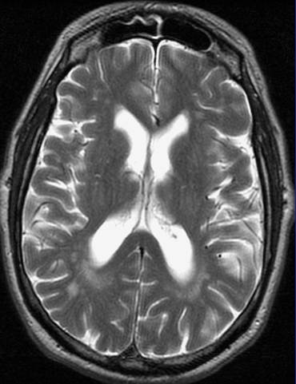
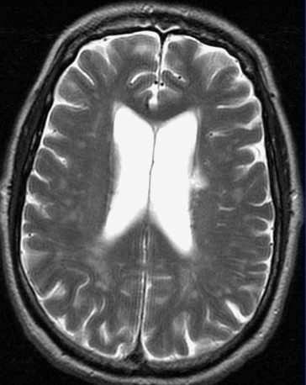
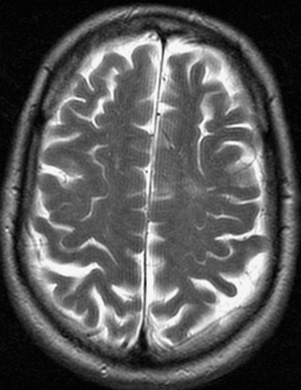
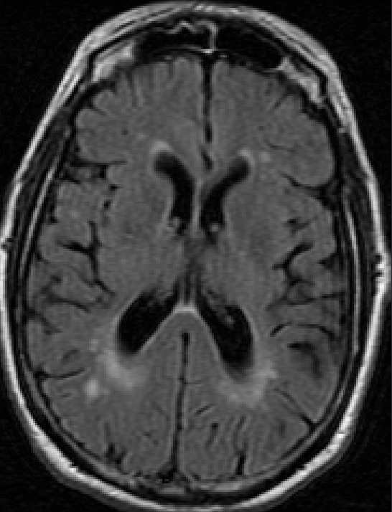
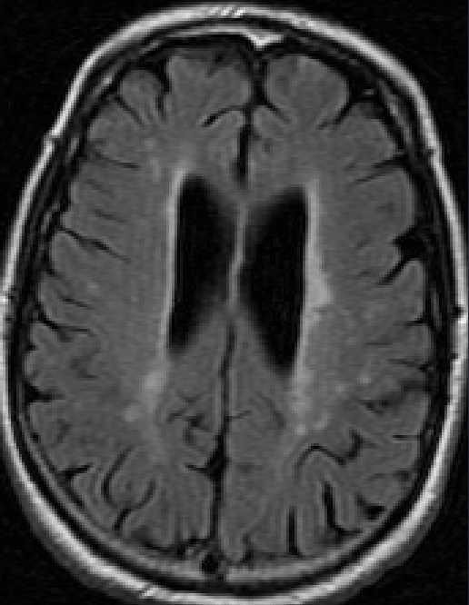
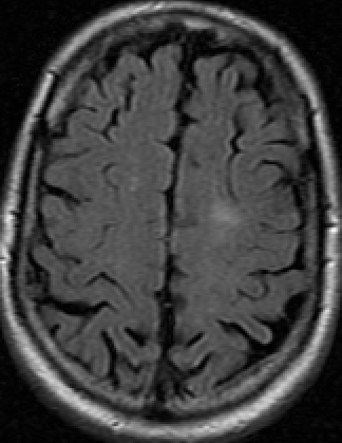
7
Ratings: Fazekas
Longstreth
Wahlund
Guide prepared by J Wardlaw, K Ferguson, University of Edinburgh
All images copyright J Wardlaw, University of Edinburgh

Slide 18
7
Ratings: Fazekas PVH 2 / DWMH 1
Longstreth 3
Wahlund 2
Guide prepared by J Wardlaw, K Ferguson, University of Edinburgh
All images copyright J Wardlaw, University of Edinburgh
Notes:
18

Slide 19
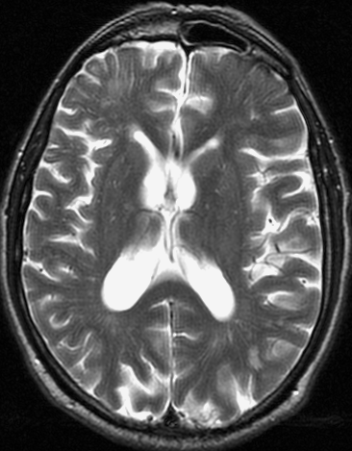
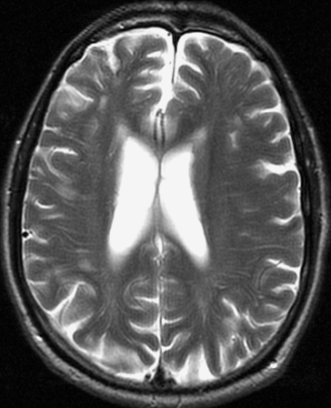
8
Ratings: Fazekas
Longstreth
Wahlund 1
Comments: What do you think the arrow is point to? How do you think that focal lesions like this should be handled when rating white matter changes?
Guide prepared by J Wardlaw, K Ferguson, University of Edinburgh
All images copyright J Wardlaw, University of Edinburgh
Notes:
Note this patient has an old partially haemorrhagic stroke lesion in the right frontal lobe (arrow). You need to ignore focal lesions like this when rating the background white matter changes.

Slide 20
8
Ratings: Fazekas PVH 1 / DWMH q
Longstreth 2
Wahlund 1.5
Comments: This case has an old partially haemorrhagic stroke lesion in the right frontal lobe (arrow). Focal lesions like this should be ignored when rating the background white matter changes.
Guide prepared by J Wardlaw, K Ferguson, University of Edinburgh
All images copyright J Wardlaw, University of Edinburgh
Notes:
20
Note this patient has an old partially haemorrhagic stroke lesion in the right frontal lobe (arrow). You need to ignore focal lesions like this when rating the background white matter changes.

Slide 21
9
Ratings: Fazekas
Longstreth
Wahlund
Guide prepared by J Wardlaw, K Ferguson, University of Edinburgh
All images copyright J Wardlaw, University of Edinburgh

Slide 22
9
Ratings: Fazekas PVH 1 / DWMH 1
Longstreth 3
Wahlund 1.5
Guide prepared by J Wardlaw, K Ferguson, University of Edinburgh
All images copyright J Wardlaw, University of Edinburgh
Notes:
22

Slide 23
10
Ratings: Fazekas
Longstreth
Wahlund
Guide prepared by J Wardlaw, K Ferguson, University of Edinburgh
All images copyright J Wardlaw, University of Edinburgh

Slide 24
10
Ratings: Fazekas PVH 2 / DWMH 1
Longstreth 3
Wahlund 1.5
Guide prepared by J Wardlaw, K Ferguson, University of Edinburgh
All images copyright J Wardlaw, University of Edinburgh
Notes:
24

Slide 25
11
Ratings: Fazekas
Longstreth
Wahlund
Guide prepared by J Wardlaw, K Ferguson, University of Edinburgh
All images copyright J Wardlaw, University of Edinburgh

Slide 26
11
Ratings: Fazekas PVH 2 / DWMH 1
Longstreth 4
Wahlund 2
Guide prepared by J Wardlaw, K Ferguson, University of Edinburgh
All images copyright J Wardlaw, University of Edinburgh
Notes:
26

Slide 27
12
Ratings: Fazekas
Longstreth
Wahlund
Guide prepared by J Wardlaw, K Ferguson, University of Edinburgh
All images copyright J Wardlaw, University of Edinburgh

Slide 28
12
Ratings: Fazekas PVH 2 / DWMH 2
Longstreth 4
Wahlund 2
Guide prepared by J Wardlaw, K Ferguson, University of Edinburgh
All images copyright J Wardlaw, University of Edinburgh
Notes:
28

Slide 29
13
Ratings: Fazekas
Longstreth
Wahlund
Guide prepared by J Wardlaw, K Ferguson, University of Edinburgh
All images copyright J Wardlaw, University of Edinburgh

Slide 30
13
Ratings: Fazekas PVH 3 / DWMH 2
Longstreth 5
Wahlund 3
Guide prepared by J Wardlaw, K Ferguson, University of Edinburgh
All images copyright J Wardlaw, University of Edinburgh
Notes:
30

Slide 31
14
Ratings: Fazekas
Longstreth
Wahlund
Guide prepared by J Wardlaw, K Ferguson, University of Edinburgh
All images copyright J Wardlaw, University of Edinburgh

Slide 32
14
Ratings: Fazekas PVH 3 / DWMH 2
Longstreth 6
Wahlund 2.5
Guide prepared by J Wardlaw, K Ferguson, University of Edinburgh
All images copyright J Wardlaw, University of Edinburgh
Notes:
32

Slide 33
15
Ratings: Fazekas
Longstreth
Wahlund
Guide prepared by J Wardlaw, K Ferguson, University of Edinburgh
All images copyright J Wardlaw, University of Edinburgh

Slide 34
15
Ratings: Fazekas PVH 3 / DWMH 3
Longstreth 7
Wahlund 3
Guide prepared by J Wardlaw, K Ferguson, University of Edinburgh
All images copyright J Wardlaw, University of Edinburgh
Notes:
34

Slide 35
16
Ratings: Fazekas
Longstreth
Wahlund
Guide prepared by J Wardlaw, K Ferguson, University of Edinburgh
All images copyright J Wardlaw, University of Edinburgh

Slide 36
16
Ratings: Fazekas PVH 3 / DWMH 3
Longstreth 7
Wahlund 2.5
Guide prepared by J Wardlaw, K Ferguson, University of Edinburgh
All images copyright J Wardlaw, University of Edinburgh
Notes:
36

Slide 37
17
Ratings: Fazekas
Longstreth
Wahlund
Comments: What do you think the arrows point to? How should this lesion be handled when rating WMH?
Guide prepared by J Wardlaw, K Ferguson, University of Edinburgh
All images copyright J Wardlaw, University of Edinburgh
Notes:
NOTE: This case has a small focal lesion – a right parietal cortical infarct (arrow) which you should ignore.

Slide 38
17
Ratings: Fazekas PVH 3 / DWMH 3
Longstreth 6
Wahlund 3
Comments: This case has a small focal lesion; a right parietal cortical infarct (arrows), which you should ignore.
Guide prepared by J Wardlaw, K Ferguson, University of Edinburgh
All images copyright J Wardlaw, University of Edinburgh
Notes:
38
NOTE: This case has a small focal lesion – a right parietal cortical infarct (arrow) which you should ignore.

Slide 39
18
Ratings: Fazekas PVH 3 / DWMH 3
Longstreth 7
Wahlund 3
Guide prepared by J Wardlaw, K Ferguson, University of Edinburgh
All images copyright J Wardlaw, University of Edinburgh

Slide 40
18
Ratings: Fazekas
Longstreth
Wahlund
Guide prepared by J Wardlaw, K Ferguson, University of Edinburgh
All images copyright J Wardlaw, University of Edinburgh
Notes:
40

Slide 41
19
Ratings: Fazekas
Longstreth
Wahlund
Comments: What do you think the arrow points to? Whre is it? How should you handle it in the WMH rating? What else is visible on this person’s images?
Guide prepared by J Wardlaw, K Ferguson, University of Edinburgh
All images copyright J Wardlaw, University of Edinburgh
Notes:
NOTE: This case has a focal lesion – a lacunar infarct – in the posterior limb of the left internal capsule (arrow) – you should ignore this for the purposes of white matter rating. Note this case also has lots of enlarged perivascular spaces – the tiny white dots on the basal ganglia on the T2-weighted images (circle).

Slide 42
19
Ratings: Fazekas PVH 3 / DWMH 3
Longstreth 7
Wahlund 3
Comments: This case has a focal lesion; a lacunar infarct in the posterior limb of the left internal capsule (arrow) which you should ignore. Note that there are also numerous enlarged perivascular spaces – the tiny white dots in the basal ganglia on the T2-weighted images (circled on the right side).
Guide prepared by J Wardlaw, K Ferguson, University of Edinburgh
All images copyright J Wardlaw, University of Edinburgh
Notes:
42
NOTE: This case has a focal lesion – a lacunar infarct – in the posterior limb of the left internal capsule (arrow) – you should ignore this for the purposes of white matter rating. Note this case also has lots of enlarged perivascular spaces – the tiny white dots on the basal ganglia on the T2-weighted images (circle).

Slide 43
20
Ratings: Fazekas
Longstreth
Wahlund
Comments:
Guide prepared by J Wardlaw, K Ferguson, University of Edinburgh
All images copyright J Wardlaw, University of Edinburgh
Notes:
43
NOTE: In this case, the white matter is diffusely abnormal throughout the cerebral hemispheres. This is about as bad as the white matter lesions can get.

Slide 44
20
Ratings: Fazekas PVH 3 / DWMH 3
Longstreth 8
Wahlund 3
Comments: In this case, the white matter is diffusely abnormal throughout the cerebral hemispheres. The case demonstrates the highest possible level of white matter lesions.
Guide prepared by J Wardlaw, K Ferguson, University of Edinburgh
All images copyright J Wardlaw, University of Edinburgh
Notes:
44
NOTE: In this case, the white matter is diffusely abnormal throughout the cerebral hemispheres. This is about as bad as the white matter lesions can get.

