Slide 1
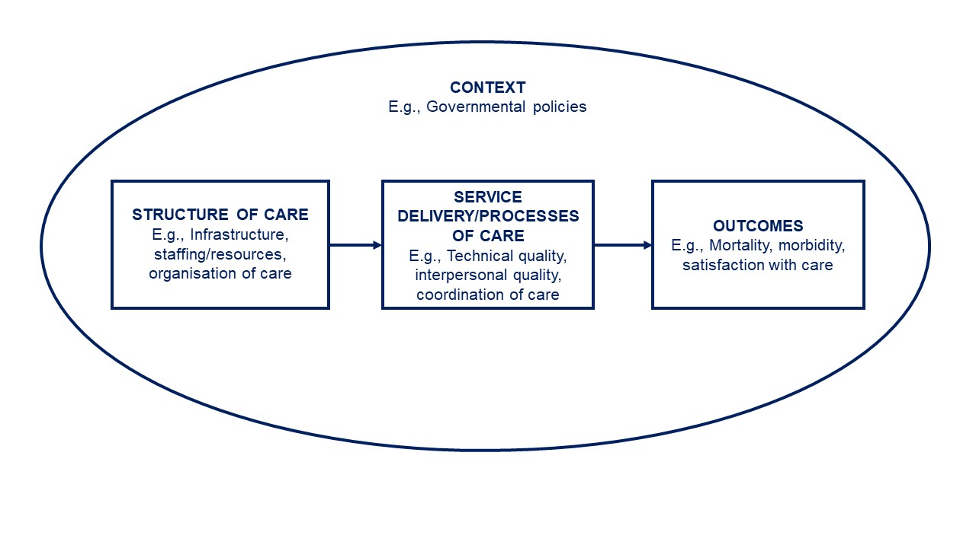
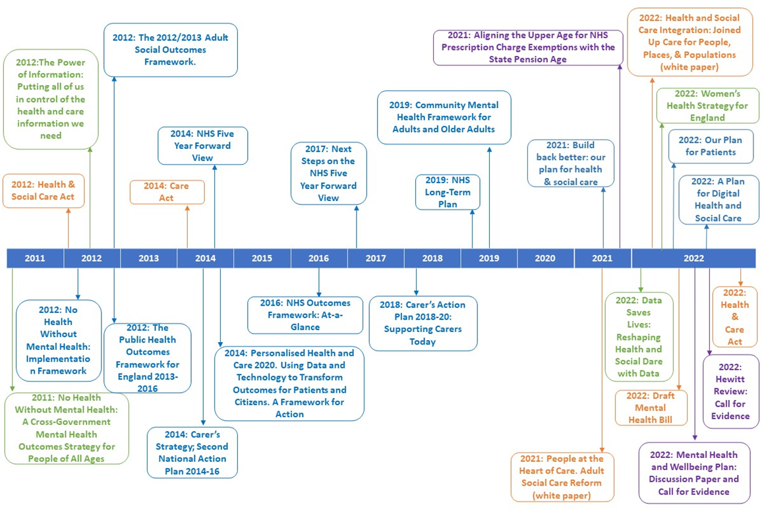
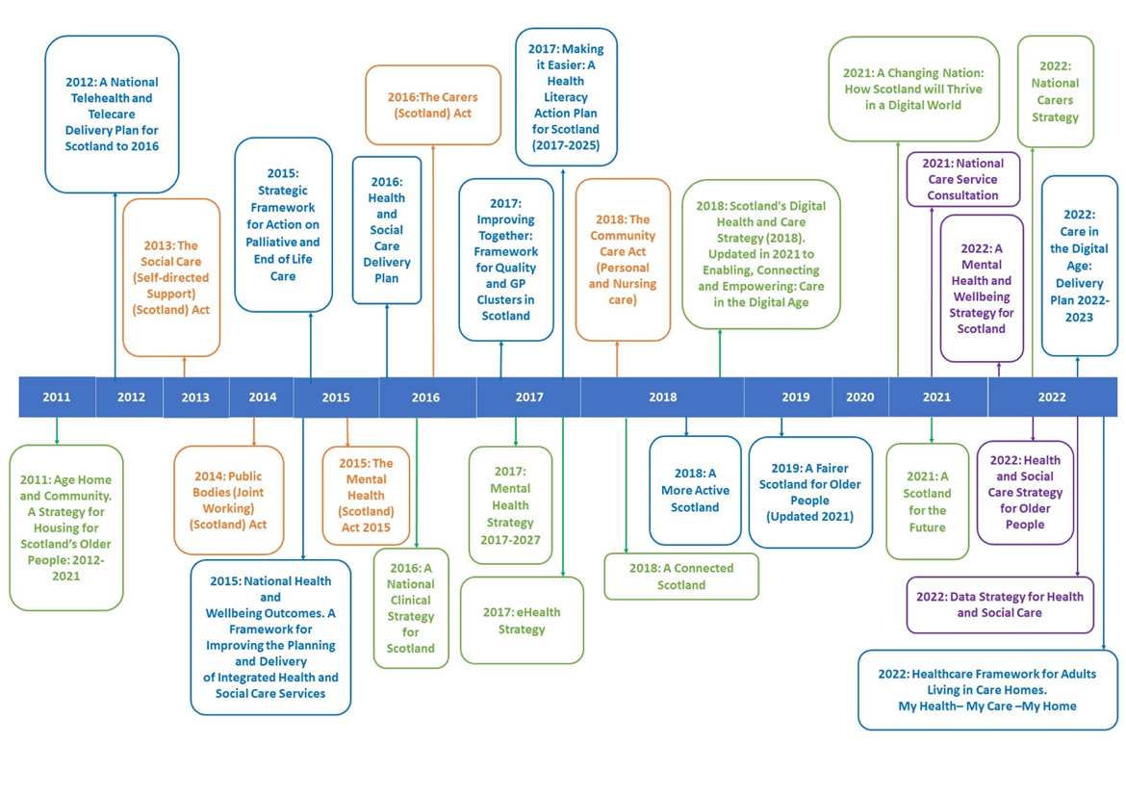
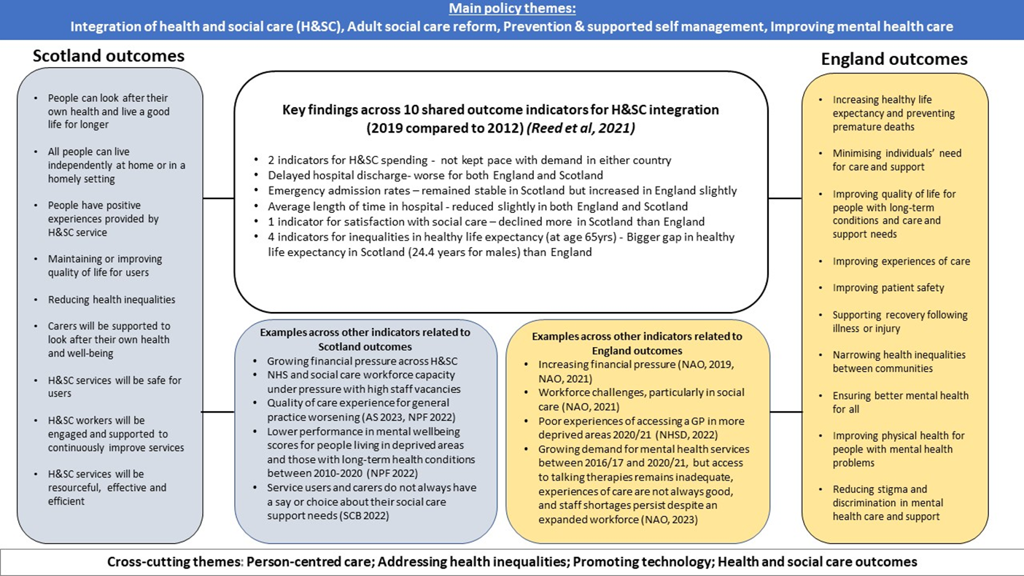
A comparative overview of health and social care policy for older people in England and Scotland
N Aujla^{*1,3,} H Frost²**, B. Guthrie², B Hanratty^{1,3}, E Kaner^{1,3}, A O’Donnell¹, S.D Shenkin², S.W Mercer²
*Joint first-authors ** Presenting author
1. Population Health Sciences Institute, University of Newcastle Upon Tyne
2. Advanced Care Research Centre, Usher Institute, University of Edinburgh
3. NIHR Applied Research Collaboration North-East North Cumbria
BACKGROUND
The United Kingdom (UK) population is ageing rapidly similar to other high-income countries [1].
Meeting the complex needs of older people is challenging in a health and care system that is single disease focused and poorly integrated
Since responsibility for health and social care was devolved to Scotland in 1999, there is evidence of diverging policy and organisation of care compared to England [2].
AIM
To provide a comparative overview of major health and social care policies in England and Scotland relating to the care of older people (aged 65+).
METHODS
We mapped macro-level policy (national, overarching policies from the government or NHS) in England (https://www.gov.uk/) and Scotland (https://www.gov.scot/) published from January 2011 to December 2023
Our focus included;
Physical and mental health
Social care, or
Wellbeing of older people.
We excluded specific health problems, such as dementia, and specific care e.g., pharmaceutical care.
Data synthesis
Identified themes were organised using an adapted structure-process-outcome model [3, 4] (see Figure 1) allowing comparison of policies across both countries.
Figure 1. Conceptual framework underpinning the review (adapted from [4, 5]
RESULTS
27 policies in England and 28 policies in Scotland were reviewed (see Figures 2 and 3)
4 main policy themes emerged, common to both countries:
Integration of care
Adult social care reform
Prevention and supported self-management
Improving mental health care
Cross-cutting themes included:
Person-centred care
Addressing health inequalities
Promoting use of technology
Improving outcomes and data
Figure 2. Timeline of policies in England from 2011-2023
Key: Government Act/Bill/white paper is orange; strategy is green; frameworks/delivery plans are blue; consultations are purple.
Figure 3. Timeline of policies in Scotland from 2011-2023
Key: Government Acts are orange; strategy is green; frameworks/delivery plans are blue; consultations are purple.
DISCUSSION & CONCLUSION
Despite diverging policies, the vision for the health and social care of older people is similar in England and Scotland.
There are differences in the structure of care e.g., a faster pace of change and financial incentivisation in England and key differences in delivery/funding of care e.g., free personal care in Scotland.
There is limited evidence to date of differences in performance and patient outcomes
There are challenges with data linkage/sharing, especially in social care
Opportunities for future research and policy recommendations include:
• An integrated, routinely collected national dataset to monitor and report comparable data across health and social care in the UK.
• More focus on understanding the impact of technology on widening social and health inequalities for older people.
• More long-term evaluation of outcomes relevant to older people.
REFERENCES & ACKNOWLEDGEMENTS
United Nations Department of Economic and Social Affairs Population Division, World population ageing 2019: highlights. 2019.
Greer, S.L., Devolution and health in the UK: policy and its lessons since 1998. Br Med Bull, 2016. 118(1): p. 16-24
Donabedian, A., Evaluating the quality of medical care. Milbank Mem Fund Q 1966. 44: p. 166–203.
Klokkerud, M., et al., Development of a framework identifying domains and elements of importance for arthritis rehabilitation. J Rehabil Med, 2012. 44(5): p. 406-13.
Choosing wisely. https://www.choosingwisely.co.uk/about-choosing-wisely-uk/
The Scottish Government. Realising Realistic Medicine: Chief Medical Officer for Scotland annual report 2015-2016. 2017 23.6.22];
The Scottish Government. A National Clinical Strategy for Scotland. 2016;
NHS five year forward view. 2014;
Reed, S. et al. Integrating health and social care. A comparison of policy and progress across the four countries of the UK. 2021.
Atkins G. et al. Devolved public services. The NHS, schools and social care in the four nations. 2021.
The authors are supported by the Advanced Care Research Centre (ACRC), which is funded by Legal and General PLC. (as part of their corporate social responsibility (CSR) programme, providing a research grant to establish the independent Advanced Care Research Centre at University of Edinburgh). The funder had no role in the conduct of the study, interpretation, or the decision to submit for publication. The views expressed are those of the authors and not necessarily those of Legal and General PLC. We thank ACRC PPI contributors for their support in the review process.
EK is supported by an NIHR Senior Investigator Award and is Director of the National Institute of Health and Care Research (NIHR) Applied Research Collaboration (ARC) North-East and North Cumbria (NENC) (NIHR200173). BH and NA are supported by the NIHR ARC NENC. AOD is also funded by a NIHR Advanced Fellowship (ADEPT: Alcohol use disorder and DEpression Prevention and Treatment, Grant: NIHR300616). The NIHR have not had any role in the design, implementation, analysis, write-up and/or dissemination of this research. The views expressed are those of the authors and not necessarily those of NIHR.

