Slide 1
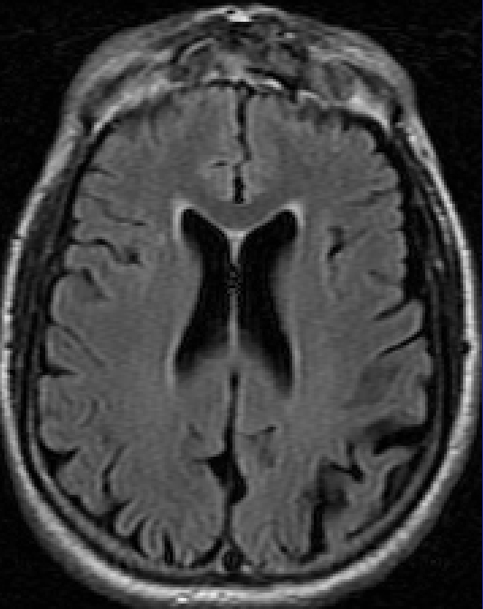
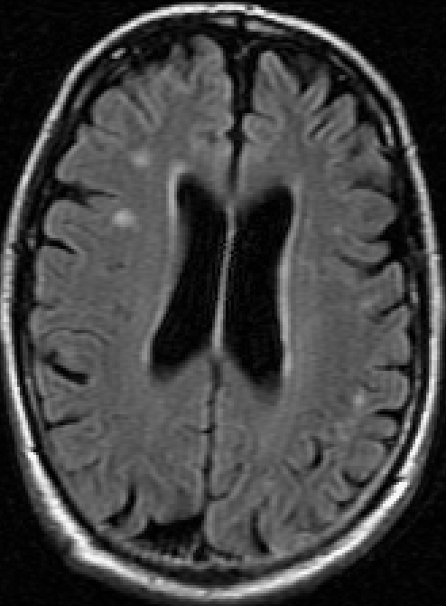
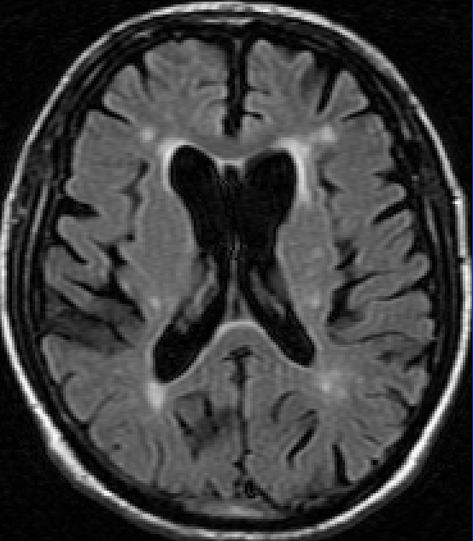
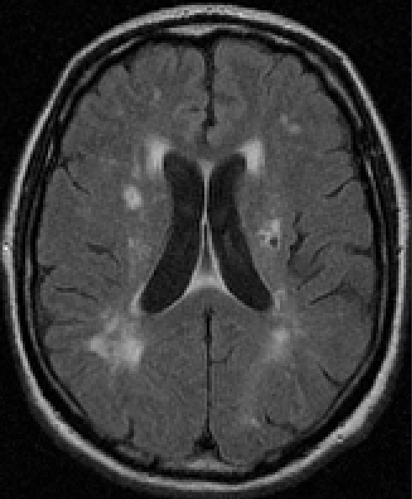
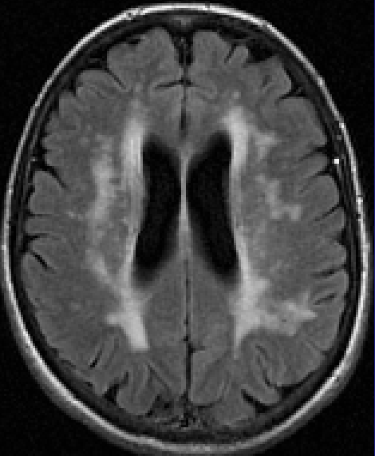
Wahlund
Wahlund et al (1990) The brain in healthy aged individuals: MR imaging. Radiology 174:675-679.
1
1.5
2
2.5
3
Image© J Wardlaw, Univ of Edinburgh
PVH and DWMH considered together and rated on a 5-point scale
“Focal” not defined; interpreted as diffuse focal lesions
1 = absent
1.5 = small solitary white matter changes
2 = multiple discrete or large solitary white matter changes
2.5 = multiple partly confluent white matter changes
3 = multiple large confluent white matter changes
Size of subarachnoid spaces and ventricles
1 = normal width or size
1.5 = normal width or size, slightly enlarged
2 = width or size larger than normal
2.5 = width or size considerably larger than normal
3 = width or size extremely larger than normal
Guide prepared by K Ferguson, J Wardlaw © Univ. of Edinburgh

