Slide 1
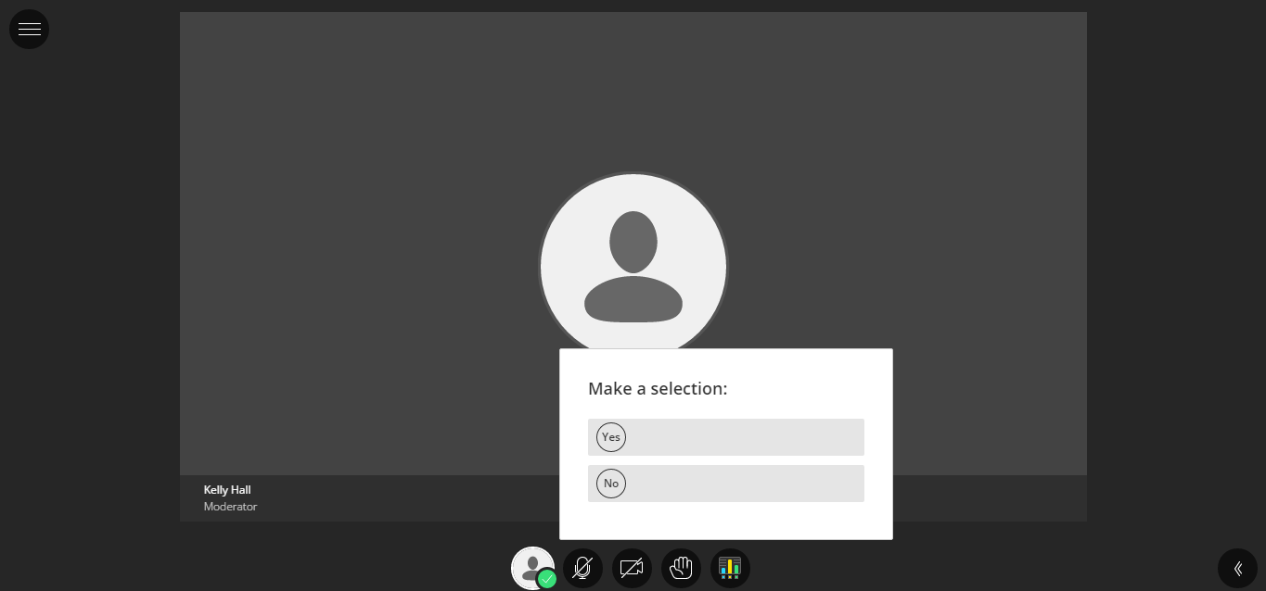
Audio check
Can you hear the presenter talking? Please choose “Yes” or “No”
www.ed.ac.uk
applyedinburgh

Slide 2
Asking questions
Always use the hand raise icon to queue up your question.
When called upon to ask your question, type a question in the “Text Chat Area”
www.ed.ac.uk
applyedinburgh

Slide 3
Recording
This session will be recorded so if you have any concerns about this, please let me know now…
www.ed.ac.uk
applyedinburgh
Notes:
Welcome to the University of Edinburgh, great to see so many of you here etc, etc.
Introduce self – SRA.
My talk is going to focus on 3 areas in relation to applying to the University:
Information sources and the preparation it would be effective for you to do before you apply
How to apply in practical terms – and I want to focus on the personal statement for a while – as that is the part of the application that staff in our academic Schools tell us is often lacking
Then we’ll take a look at what you can expect from us and what we need you to do after you have applied
Hopefully together, the information provided will support you in getting the best start in the application process and to ensure that it goes as smoothly as possible for you.

Slide 4
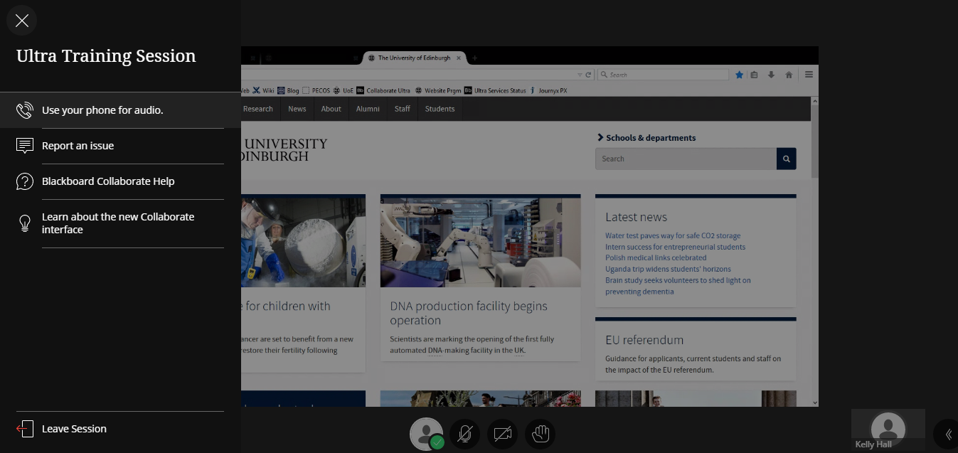
Thank you!
When the session is over and you are ready to leave click on the browser’s Close button or Leave Session icon
www.ed.ac.uk
applyedinburgh
Notes:
Context here is where the applicant is expected to develop their own research proposal that aligns with wider research expertise in the School. And is probably an example of a situation where although the applicant doesn’t need to have found a supervisor before they apply , it would be beneficial to have had some feedback from the School on the nature of the proposal prior to submission – to confirm that it is relevant and has the potential to be supervised by a member of academic staff.

