Slide 1
Effects of antiplatelet therapy after stroke due to intracerebral haemorrhage: main results of the REstart or STop Antithrombotics Randomised Trial (RESTART)
RESTART Collaboration
www.RESTARTtrial.org
@bleedingstroke

Slide 2
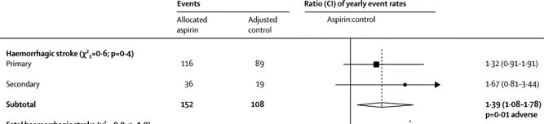
Effects of aspirin for secondary prevention of occlusive vascular disease
Antithrombotic Trialists’ (ATT): aspirin reduces risk of major vascular events
Might increase risk of intracerebral haemorrhage (ICH)
Lancet 2009;373:1849-60

Slide 3
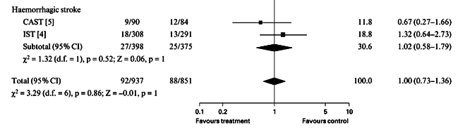
Start or avoid antiplatelet therapy for secondary prevention after ICH?
Systematic reviews
Effects of ~2 days’ aspirin after ICH on stroke recurrence
Observational studies
  Starting antiplatelet therapy associated with lower risk of occlusive vascular events and no difference in haemorrhagic events
Randomised trials (Jan 2019)
  No complete published RCTs
J Neurol Sci 2018;384:133–38
Cochrane DSR 2017;5:CD012144
Cerebrovasc Dis 2002;14(3-4):197-206

Slide 4
RESTART design
We aimed to estimate
  the effects of starting versus avoiding antiplatelet therapy on the risk of recurrent symptomatic spontaneous ICH
  whether this risk might be greater than any reduction of occlusive vascular events
Recruit 720 participants and follow-up for 2 years
  ICH event rate 1·8%–7·4%
  Relative risk of ICH with antiplatelet therapy 1–4
ISRCTN71907627 | Trials 2018;19:162 | Trials 2019;20:183

Slide 5
Adults ≥18y, taking antithrombotic (antiplatelet or anticoagulant) therapy for the prevention of occlusive vascular disease at ICH onset, who discontinued antithrombotic therapy, and survived ≥24h
Brain MRI before randomisation
Randomisation (central)
1:1
START antiplatelet therapy*
AVOID antiplatelet therapy
Follow-up (central, masked) for vascular events, death, mRS, adherence, BP control
* Aspirin or clopidogrel or dipyridamole (open, no placebo)

Slide 6
Pre-specified outcomes
Primary
  Recurrent symptomatic spontaneous ICH
Secondary
  All major haemorrhagic events
  All major occlusive vascular events
  All major haemorrhagic or occlusive vascular events
    (Protocol had specified all major vascular events defined by the ATT collaboration)
Trials 2018;19:162 | Trials 2019;20:183

Slide 7
Consented May 2013 – May 2018 (n=562)
Not randomised (n=25)
Ineligible (n=6), patient deteriorated (n=7), clinician (n=4) or patient/carer (n=7) not uncertain about antiplatelet drug use, consented after end of recruitment (n=1)
Randomised (n=537)
Ineligible (n=16): prescribed low dose heparin (n=4), haemorrhagic transformation of ischaemic stroke (n=5), subarachnoid haemorrhage (n=3), intraventricular haemorrhage (n=3), meningioma (n=1)
Start antiplatelet therapy (n=268)
Avoid antiplatelet therapy (n=269)

Slide 8
Start antiplatelet therapy (n=268)
Avoid antiplatelet therapy (n=269)
Lost (n=0)
Lost (n=0)
Withdrew (n=0)
Withdrew (n=1)
Died before discharge (n=3)
Died before discharge (n=1)
First follow-up (n=265)
First follow-up (n=267)
Analysed (n=268)
Analysed (n=268)

Slide 9
Baseline characteristics
 | Start antiplatelet therapy (n=268) | Avoid antiplatelet therapy (n=269)
Male, n (%) | 173 (65%) | 187 (70%)
Median age, years (IQR) | 77 (69-82) | 76 (69-82)
Lobar supratentorial ICH location | 166 (62%) | 166 (62%)
Median time since ICH, days (IQR) | 80 (30-149) | 71 (29-144)
≥0·15 probability of good 6m outcome | 220 (82%) | 218 (81%)
Intended antiplatelet therapy that would be prescribed if randomised to start
Aspirin | 149 (56%) | 150 (56%)
Clopidogrel | 117 (44%) | 112 (42%)
Other | 2 (<1%) | 7 (2%)

Slide 10
Primary outcome: recurrent ICH
Start vs. avoid antiplatelet therapy
Adjusted HR 0·51 (0·25–1·03): p=0·060
Unchanged in unadjusted and adjusted models, and sensitivity analyses
No heterogeneity in sub-group analyses
Adherence 99% after randomisation, 82% @ 4y
Median systolic BP 130mmHg throughout
Avoid: n=23/268 (8·6%)
Start: n=12/268 (4·5%)
Follow-up time (y): median 2·0y, 99·3% complete

Slide 11
Secondary outcomes
 | Start antiplatelet therapy (n=268) | Avoid antiplatelet therapy (n=268) | Adjusted HR (95%CI) | p value
All major haemorrhagic events | 18 | 25 | 0·71 (0·39–1·30) | 0·27
All major occlusive vascular events | 39 | 38 | 1·02 (0·65–1·60) | 0·92
All major haemorrhagic or occlusive vascular events | 54 | 61 | 0·86 (0·60–1·24) | 0·43
Major vascular events (protocol, ATT definition) | 45 | 65 | 0·65 (0·44–0·95) | 0·025

Slide 12
Starting antiplatelet therapy after ICH associated with antithrombotic drug use
Reassuring effects on recurrent ICH
  Lower than the increase in risk expected (RR=1·67 in ATT trials)
  Antiplatelet therapy might reduce the risk of recurrent ICH
    HR 0·51 (95% CI 0·25–1·03), p=0·060
  Any possible increase in risk seems too small to exceed the established benefits of antiplatelet therapy
No heterogeneity in sub-groups, but estimates imprecise
Recruit to ongoing trials (RESTART-Fr, STATICH)
www.RESTARTtrial.org
@bleedingstroke

Slide 13
Thank you to everyone who helped…
Participants, relatives, and carers
Primary care practitioners
Collaborators: at 122 hospitals in the UK
Trial management group: K Innes (senior trial manager); L Dinsmore (imaging manager); J Drever (data manager); C Williams (centre coordinator); D Perry, C McGill, D Buchanan, A Walker, A Hutchison, C Matthews (database programmers); R Fraser, A McGrath, A Deary, R Anderson, A Maxwell, P Walker (trial support officers); J Stephen, C Holm Hansen, R Parker, A Rodriguez (unmasked independent statisticians)
Trial steering committee: Independent members: C Baigent (chair), J Carrie (patient–public representative), D Lasserson, F Sullivan. Others: R Al-Shahi Salman (chief investigator), MS Dennis, GD Murray, DE Newby, PAG Sandercock, CLM Sudlow, WN Whiteley, N Sprigg, DJ Werring, PM White
Data monitoring committee: J Bamford (chair), J Armitage, J Emberson, GJE Rinkel, G Lowe
Outcome event adjudicators: WN Whiteley, MR Macleod (internal); T Gattringer (external)
Systematic Management, Archiving and Reviewing of Trial Images Service (SMARTIS): JM Wardlaw (director), J Palmer, E Sakka, J Adil-Smith
Brain imaging assessors: PM White, DP Minks, D Mitra, P Bhatnagar, JC du Plessis, Y Joshi
Funder: British Heart Foundation (S Amoils)
Sponsor: ACCORD (J Rojas)
Clinical research networks: NIHR clinical research network, NRS Scottish Stroke Research Network, SINAPSE collaboration
Clinical trials unit: Edinburgh Clinical Trials Unit
TICH-2 trial team: co-enrolment
Peer reviewers: ?
Editors and publisher…
www.RESTARTtrial.org
@bleedingstroke

Slide 14
Online in The Lancet & The Lancet Neurology…
Main results
Imaging sub-groups
www.RESTARTtrial.org
@bleedingstroke

Slide 15
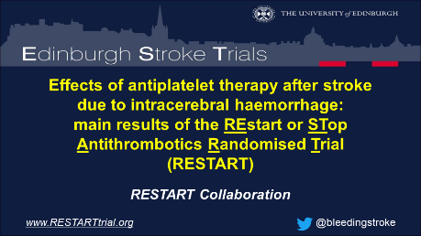
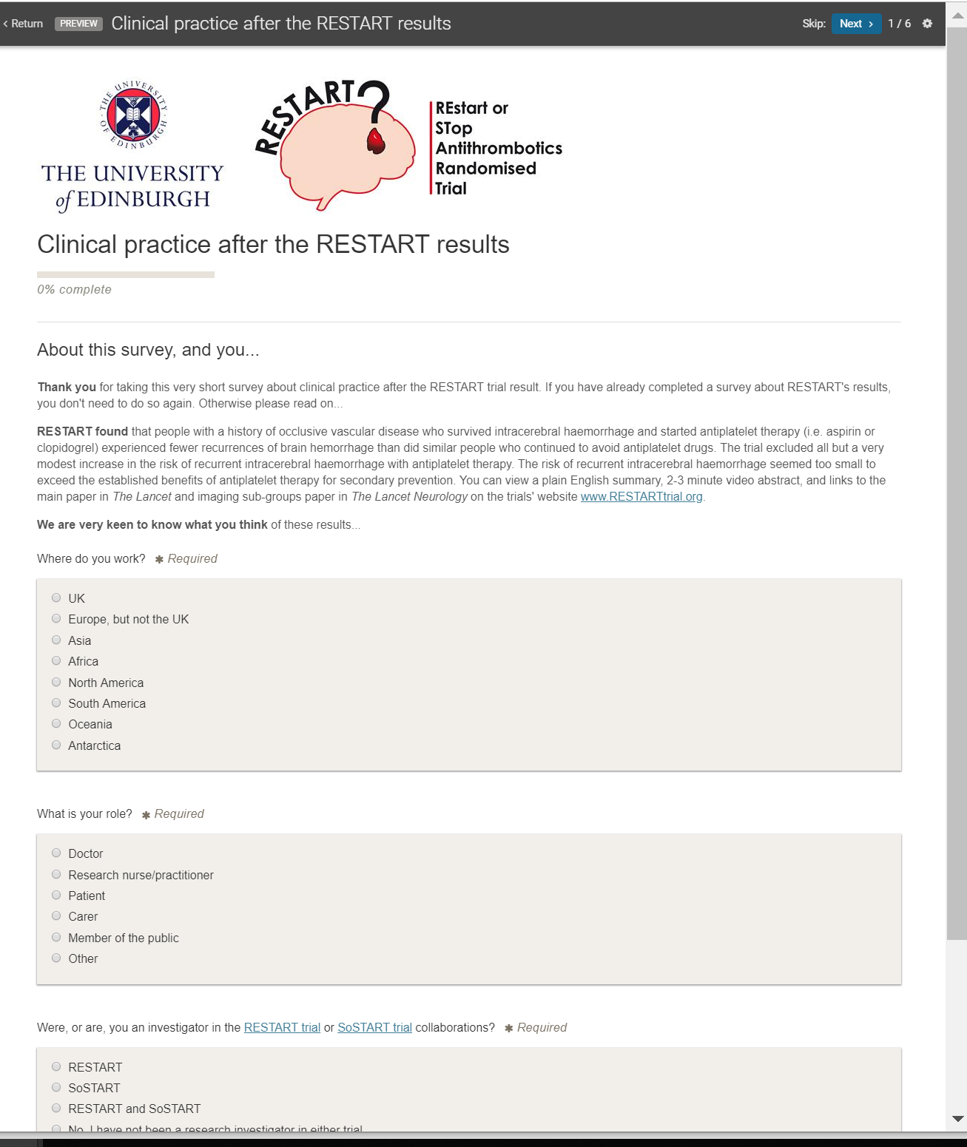
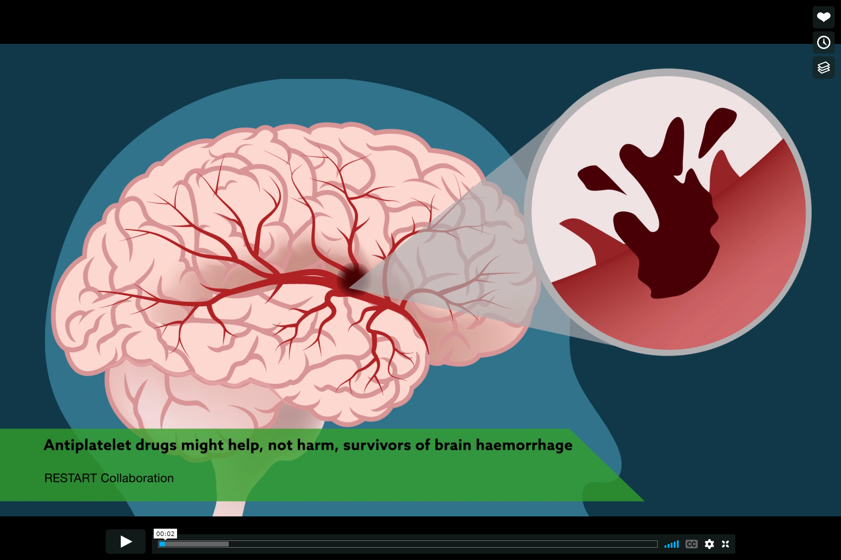
Get resources and share your opinion…
www.RESTARTtrial.org
@bleedingstroke

