Slide 1
Notes:
We have an hour together to spend some time exploring the Learning & Development Toolkits for both our personal and team development.
Each of the toolkits links to between 6-8 online resources. You can chose from:
Something to watch: a short video or Lynda.com online learning
Something to look at: an infographic
Something to read: a how to guide, top tips or article
Something to do: a questionnaire or interactive e-learning module
Something to listen to: a podcast or experts to tips

Slide 2
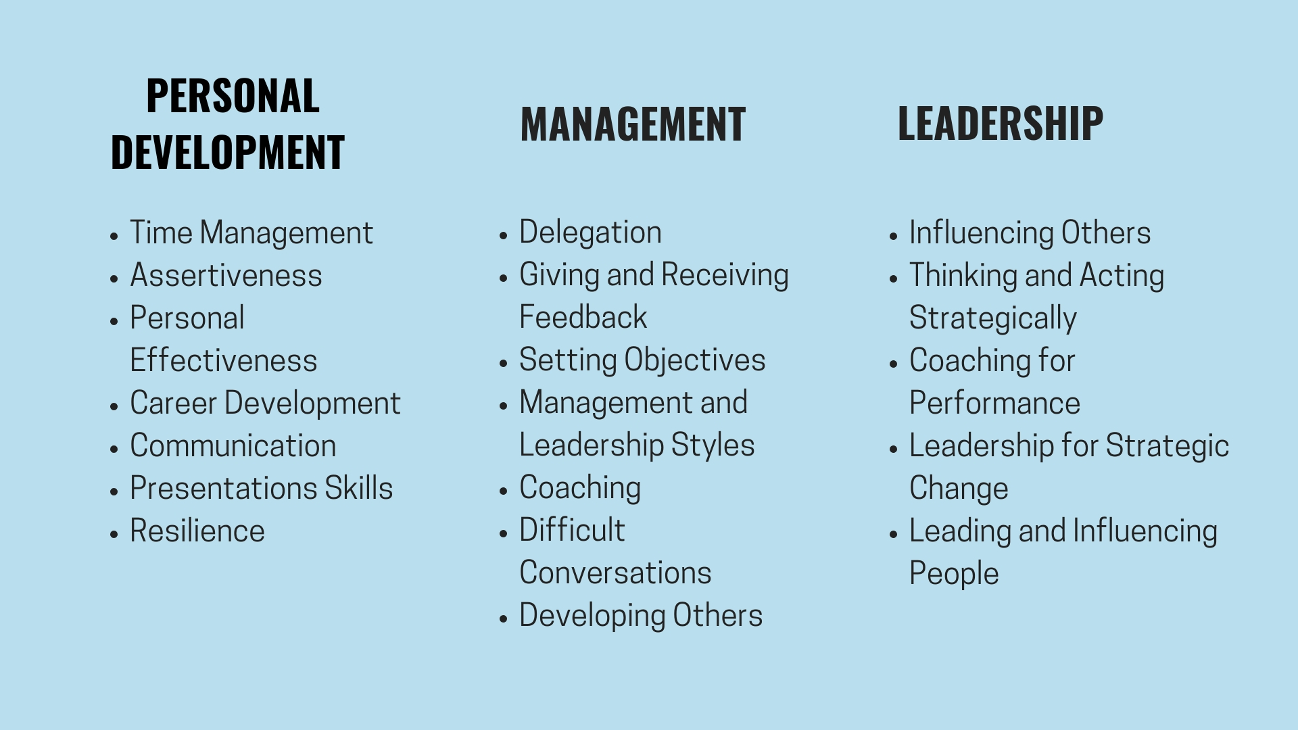
Notes:
The toolkits are available to all staff and can be found on the Learning & Development web pages under the following headings:
Personal Development
Management
Leadership
You don’t have to be a manager or leader to access the toolkits under those headings.

Slide 3
Notes:
You might want to access a toolkit if:
you’re stuck on something at work. Just like when you might google how to fix something that’s broken at home.
You want to work on your development but can’t get a space on a workshop or would struggle to take a full day out
You need to have a conversation or present at a meeting and you don’t know where to begin.

Slide 4
Notes:
You don’t need to ‘complete’ a toolkit. You can access development by the topic that your interested in (e.g. presentation skills, communication, time management) or by the type of resource that you prefer (e.g. watch a video or take a quiz).

Slide 5
Notes:
Think of it like a pick and mix – you take what you need from the toolkits when you need it.

Slide 6
Notes:
There are a few ways to put what you learn into practice:
Try it out straight away
Share the resource with your colleagues or team
Discuss it with your manager or at a team meeting

Slide 7
Notes:
Let’s take a closer look:
Log onto web pages:
https://www.ed.ac.uk/human-resources/learning-development
Click through to courses and resources and show the team the different headings
https://www.ed.ac.uk/human-resources/learning-development/courses
Got to the Giving & Receiving toolkit and explain that:
all of the toolkits have the same layout.
RIGHT CLICK on the resource title or icon to access the resource in a new tab (open in chrome)
You’ll need to use your ease log in to access Lynda.com or Online Development Toolkit.
show the team the SARAH video (ease log in requires):
https://www.ed.ac.uk/files/atoms/files/giving_receiving_feedback.pdf
Ask the team to reflect on the questions.

Slide 8
Notes:
In pairs pick a toolkit each that you’re going to look at (different toolkits!)
Spend 15 minutes looking at the toolkit and then 10 minutes discussing what you learned.

Slide 9
Notes:
In group(s) discuss these questions..
Come back together as a group to discuss and commit to any actions.

