Slide 1
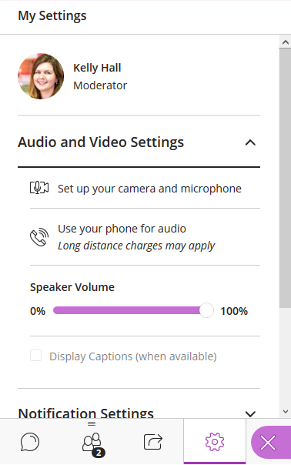
Welcome to Learn: Using Collaborate in Learn
Information Services Group, Educational Design and Engagement Team
Please run through the following before we begin:
Step 1: Click on the purple tab (bottom right)
Step 2: Set up camera and microphone settings
Open Collaborate Panel Icon at (bottom right) > My Settings icon (looks like a cog).
Click on Audio and Video Settings, then Set Up your Camera and Microphone.
Preview your audio and camera.
Step 3: Set up speaker and microphone volume
My Settings icon.
Click on Audio and Video Settings and adjust your speaker and microphone volume.
My Settings Icon

Slide 2
Audio Check
I’m now talking - Can you hear me ok?
Please indicate yes or no using the text chat tool.
The Chat is accessed via the purple tab in the bottom right corner.

Slide 3
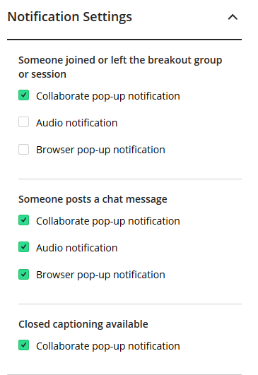
Your Notification Settings
To change your notification settings go to the Collaborate panel (purple button at bottom right)
Select My Settings
Select Notifications Settings.
Switch off all audio notifications.

Slide 4
During the Q&A Session
Use the hand raise icon to queue up your question.
When called upon to ask your question type a question in the Chat.
Or click on the Audio icon then speak your question.

Slide 5
VIRTUAL CLASSROOMS
Etiquette
During discussions, please use the raise your hand function and wait for the lecturer or facilitator to ask you to speak.
Mute your microphone unless it’s your turn to speak.
You can type a question or comment at any time in the text chat.
Why is my name displayed? Your name is displayed to the lecturer or facilitator and the other students and you are able to see their names. This is to help keep the learning space secure, support academic community and student engagement, and run the session effectively.
Do I have to turn my video on? No, you don’t have to. However turning your video on when you speak can make it easier for us to get to know each other and work together.
Identity
Your lecturer will tell you whenever recording starts and stops.
Who can view the recording? Only the students and staff on this Course. You must not share it further.
To do so would breach University regulations, copyright law and, perhaps most importantly, the trust that’s required between us all to keep your learning environment safe.
What if I don’t want to be recorded? You can ask the lecturer in advance of the lecture, or during it, to stop recording while you contribute.
Is the text chat recorded? Normally, yes. The lecturer or facilitator will tell you whether the chat is anonymous or identifiable.
This class may be recorded

Slide 6
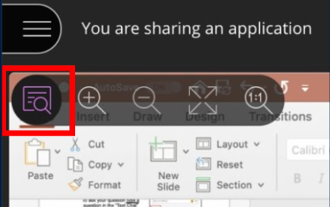
Viewing the Screen
You can change the view of your screen by using the tools in the top left corner or double click on the collaborate window

Slide 7
Using Blackboard Collaborate in Learn
Kelly Hall

Slide 8
Using Blackboard Collaborate for Digital Teaching
1 hour introduction to using Collaborate with Learn
40 minute Demo | Requirements for using Collaborate Set up Collaborate within Blackboard Learn Giving students access to Collaborate through Learn How to record a session, upload slides, and manage students Tips for running a session
Remainder of session | Question and Answer

Slide 9
What is Blackboard Collaborate?
Blackboard Collaborate is the University’s supported virtual classroom tool.
Collaborate is available to all staff and students.
It is integrated with Blackboard Learn (the University’s Virtual Learning Environment).
Requiring students to access Collaborate through Learn keeps sessions secure.

Slide 10
Requirements
Internet connection (preferably wired)
Google Chrome recommended for best experience
Headset (recommended)
Computer (or mobile device for Participants)
Participants and External Guest
Do not need access to University systems
Can send them a “guest link/URL”

Slide 11
Roles & permissions in Collaborate
Moderator: full control over all content being shared, session settings & can manage attendees.
Presenter: limited control to present. Presenters can upload, share, edit, and stop sharing content.
Participant: watch and listen only unless communication tools are enabled by moderator.
Captioner: types what is being said in real time.

Slide 12
Demo: Setting up a Collaborate session in Learn

Slide 13
Poll: Favourite Ice Cream Flavour?
Chocolate
Vanilla
Pistachio
Strawberry
Other – not an option above
CC0 – assorted ice cream

Slide 14
There are several options available on the Share Content tab. The first is the Whiteboard. This allows drawing, text, shapes, can create multiple whiteboard pages and share with breakout groups

Slide 15
Feel free to try out the whiteboard here!

Slide 16
Uploading slides to Collaborate Share Content tab > Share Files
Advantages:
Uses less bandwidth – more likely to work if you or attendees have poor internet connection.
Once uploaded the slides stay in the Collaborate session and can be re-used in the future.
Disadvantages:
Slides’ appearance may change when uploaded to Collaborate. Save the slides as PDF in PowerPoint first, then upload the PDF to Collaborate.
PowerPoint slides uploaded to Collaborate lose all animations, links and audio/video. If you need animations etc. for your presentation, open the slides in PowerPoint on your computer, then share your screen in Collaborate (uses more bandwidth).
Maximum file size for uploaded files is 60MB per file (125MB total).
Notes:
To share screen in Collaborate – Use Chrome browser > Share Content tab > Share Application/Screen > Share Screen (tick ‘share audio’ box if sound required, e.g. for a video)
https://help.blackboard.com/Collaborate/Ultra/Moderator/Moderate_Sessions/Share_Content#share-files_OTP-2
How to reduce PowerPoint file size: https://support.microsoft.com/en-us/office/reduce-the-file-size-of-your-powerpoint-presentations-9548ffd4-d853-41e7-8e40-b606bca036b4

Slide 17
How to manage students 1
Use etiquette slides to set the expectations of how the session will run.
Apply the Session Settings to limit interaction, as appropriate.
Use Raise Hands to create an ordered queue for questions.

Slide 18
Raise Hands functionality

Slide 19
How to manage students 2
Mute individual attendees: From the Attendees panel, point to an attendee with their audio on. Select Attendee controls. Select Mute.
Mute all attendees: Select More options at the top of the Attendees panel. Select Mute All.

Slide 20
Tips for running a session 1
Use latest stable version of Google Chrome (preferred browser)
Run the ‘Set up your camera and microphone” check at the start.
To talk select “Share Audio” turn off mic when done speaking to prevent feedback.
To display webcam select “Share Video”
Go into the session early to upload your slides (PPT or PDF) and troubleshoot any issues.
Close all programs or streaming services not required. (MS Teams)

Slide 21
Tips for running a session 2
Put up a welcome slide
Welcome people to the session using the text chat
Make sure everyone can hear you
Limit video use
Limit application sharing
Use polls or groups to break up the session
Send link to Troubleshooting webpage if people have issues hearing you (will post in chat)
Have an extra moderator to manage chat

Slide 22
Q & A
Please write your questions in the chat or raise your hand if you’d like to ask a question using the audio.
What? By Véronique Debord-Lazaro CC-BY-SA 2.0

Slide 23
Further Resources
University’s Teaching Continuity Preparation webpages: https://www.ed.ac.uk/information-services/learning-technology/more/teaching-continuity
University’s Collaborate webpages: https://www.ed.ac.uk/information-services/learning-technology/communication
Blackboard Collaborate Support Portal: https://en-us.help.blackboard.com/Collaborate/Ultra
Session Best Practices: https://www.ed.ac.uk/information-services/learning-technology/communication/good-practice

Slide 24
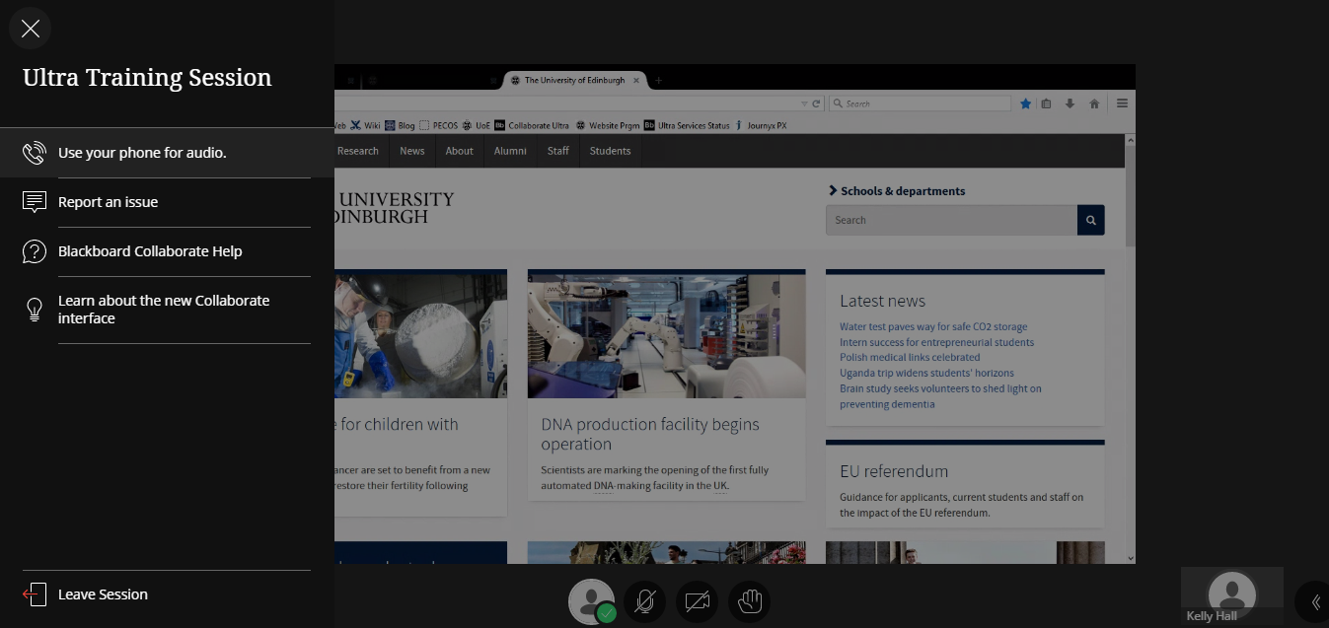
Thank you!
When the session is over and you are ready to leave click on the browser’s Close button or Leave Session icon

Slide 25
Contingency Slides
If required to replace live demo of Collaborate

Slide 26
Demo: Setting up a Collaborate session in Learn

Slide 27
Choose a content area in Learn to which you will add the link to Collaborate.

Slide 28
To add the link: Hover over Tools Click More Tools Click Blackboard Collaborate Ultra

Slide 29
Change Link Name, if desired. Add some text as signposting for the students. Example text on next slide.

Slide 30
Example advice to give to students
Click on this link to enter Collaborate. Once there you will see a list of upcoming sessions. You will also be able to access recordings of previous sessions – just click on the icon in the top left to switch the view from sessions to recordings.
To get the best experience with Collaborate use:
Wired connection (if possible)
Chrome is the preferred browser but you can also use Firefox, Edge (Chromium) or Safari.
Headset (optional but recommended)
PC/laptop/mobile device
For help see our web pages: Collaborate web pages
Or contact IS.Helpline@ed.ac.uk

Slide 31
Each course has an open Course Room. Created sessions can be for particular dates and times. Click Create Session to create your own.

Slide 32
Recordings are accessed from the same area. Click on the hamburger icon and select Recordings to view. Click on recording name to watch online.

Slide 33
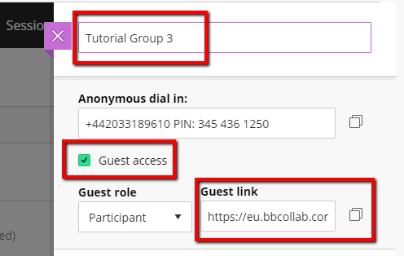
Name your session clearly as all sessions are visible. A Guest link is available if Guest Access is selected.

Slide 34
Set date and Start and End times as appropriate. Use Repeat session option for sessions that repeat on a daily, weekly or monthly basis. Set Early Entry to allow set up in advance.

Slide 35
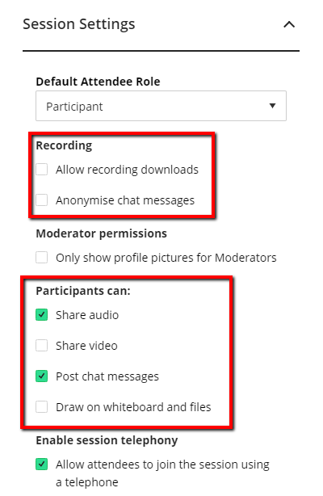
Check the options if you want to allow downloads of recordings or anonymise the chat window. Choose the functions Participants have on entering the room. Click on Save when finished.

Slide 36
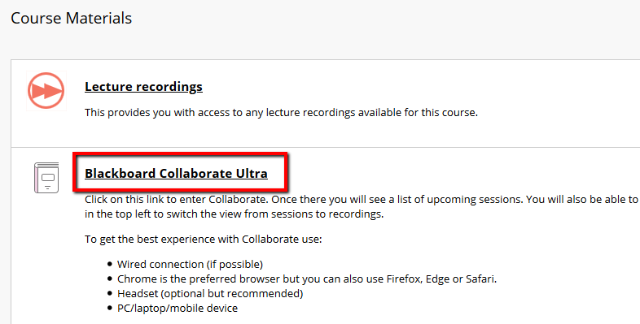
To enter your session on the day. Go to the Content area in Learn where you added the link to Collaborate. Click on the link to enter Collaborate.

Slide 37
Click on the active session. In the panel that appears, click on Join session. This will open the session in a new browser tab.

Slide 38
Open the Session menu and select Start Recording. To finish recording, open the Session menu and select Stop Recording. It will show up in the Learn course some time after the session is over.

Slide 39
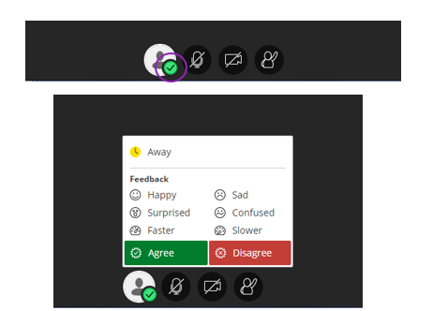
Emoticons and Feedback
Click on the green tick
Then choose your emoji Happy / Agree. This will then appear next to your name for 10 seconds.
View reactions across the cohort in the Attendee list.

Slide 40
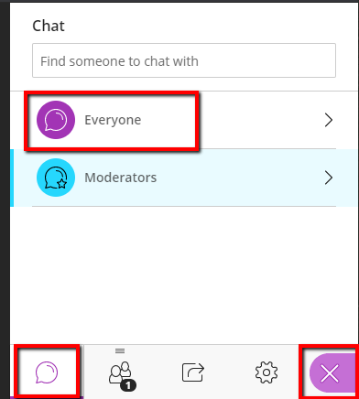
Chat via the Collaborate Panel – purple tab in the bottom right. The Everyone chat area is the main chat room. There is also a private chat area for Moderators.

Slide 41
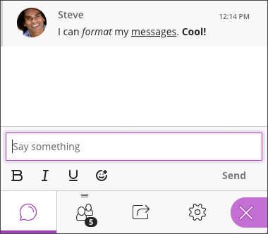
Once in a chat area, click on the text area at the bottom and start typing your message. Press the return key to send the message to the room. A range of emojis are also available.

Slide 42
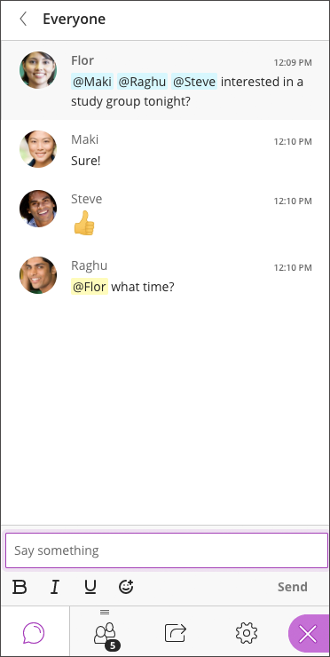
Once in a chat area, click on the text area at the bottom and start typing your message. Click the @ button and type the name hit return and the person will get a notification of the messsag

Slide 43
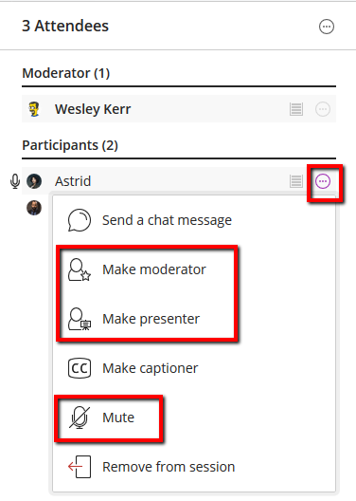
The second tab is the Attendees tab. For an individual attendee, you can change their role within the session. You can also mute their microphone if it has been left open.

Slide 44
If there is a lot of background noise, you can also choose to mute all attendees. You can also detach the attendee panel so that it is visible beside the Chat.

Slide 45
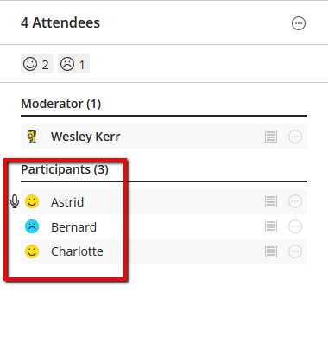
The Attendee tab is where you can see the participant feedback. You can see an aggregated count as well as individual responses.

Slide 46
There are several options available on the Share Content tab. The first is the Whiteboard. This allows drawing, text, shapes, can create multiple whiteboard pages and share with breakout groups

Slide 47
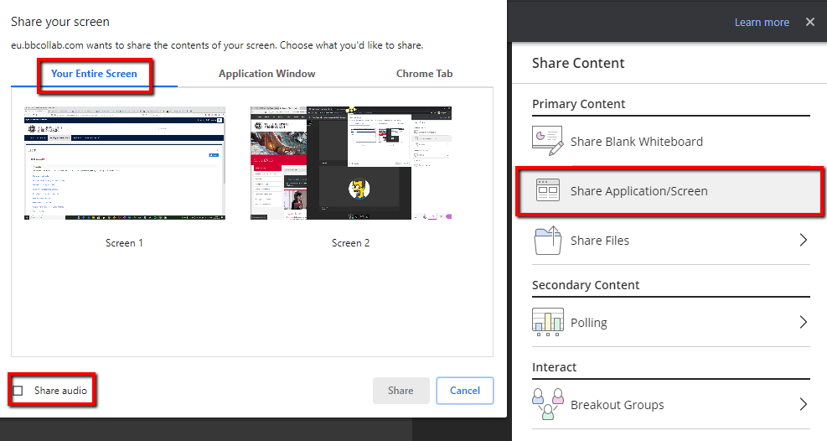
The second sharing option is Share Application/ Screen. You can choose to share Your Entire Screen. With Share Audio enabled, you can play audio or video files.

Slide 48
A second option is to share any open application on your device. This restricts the view to just the application. This prevents attendees seeing any system or app notifications.

Slide 49
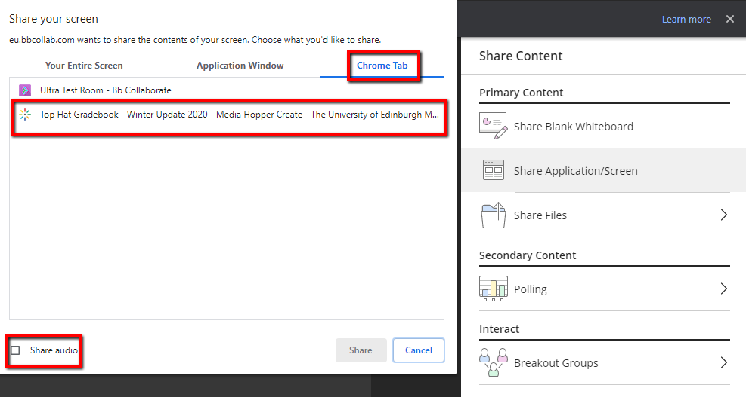
The third option is to share another open tab in Chrome. With Share Audio enabled, you can play audio or video files on Media Hopper.

Slide 50
The third content sharing option is Share Files. You can share image, PowerPoint or PDF files. Select an uploaded file and click Share Now.

Slide 51
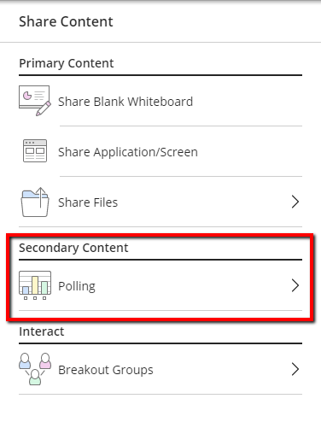
Polling adds some interactivity to your session. Polls cannot be set up in advance and results cannot be saved.

Slide 52
There are two question types available: Multiple Choice Yes/No Choices

Slide 53
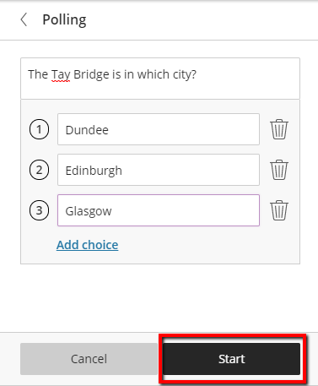
Ask a question verbally, cut and paste from another application or type your question into the text box. You can have up to five options. Click Start to begin the poll.

Slide 54
The Attendee list shows the response from each participant. Aggregated responses are only visible to the Moderator. Click Show Responses to display to attendees. Click the stop button to end the activity.

Slide 55
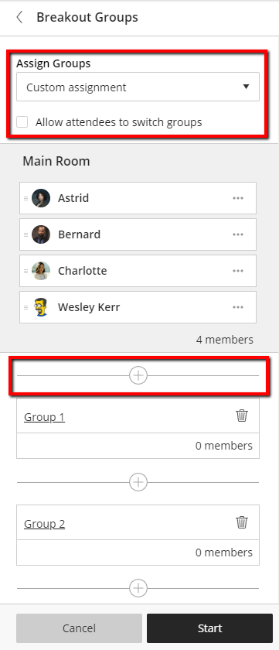
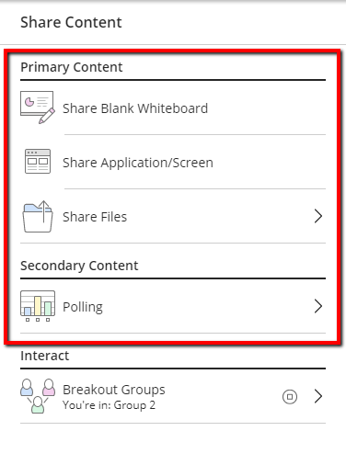
Breakout groups have their own private collaborative tools. Group activity is independent of the Main room. Two options to set up – custom or random assign.

Slide 56
With the Custom Assignment option, drag attendees and drop into groups.

Slide 57
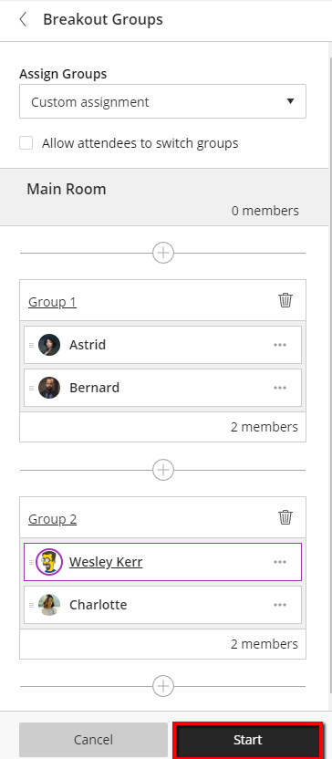
Once you have assigned all the attendees to a group, click on Start to send them to the groups.

Slide 58
With the Randomly Assign option, you can choose the number of groups to create. Use the Shuffle option to re-assign attendees if you don’t like the group compositions.

Slide 59
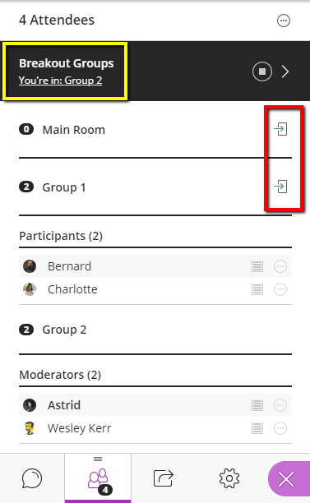
Once groups have started, you can use the move icon to switch between groups. Attendees can also do this if you enable the option to do so when setting up the groups. Use the Stop button to end the groups activity and return everyone to the main room.

Slide 60
The final tab is the Settings tab. Click on your avatar to change the picture used. You can re-check your web cam and microphone from here.

Slide 61
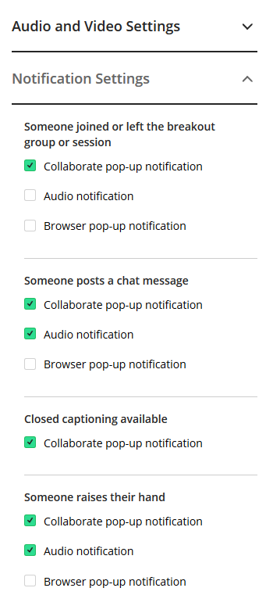
In the Notification Settings section, change which audio and visual notifications Collaborate sends to you during a session.

Slide 62
In the Session Settings section, change which functions are available to participants. You can change these during a session as often as required.

Slide 63
Licence
These resources were created by staff at The University of Edinburgh. Unless otherwise stated, all content is released under a CC BY-SA license.

