Slide 1
Careers Service Virtual Support for School of Informatics
Steve Norman
Careers Consultant

Slide 2
Focus on your studies, if you have assessments or exams coming up – that’s the priority just now. We’ll be here when you’re ready.
What is important to you right now?

Slide 3
The Careers Service is open – virtually!
Our BLOG has all the latest updates!
https://blogs.ed.ac.uk/careersinformed/
MyCareerHub www.mycareerhub.ed.ac.uk
For appts, events (online) , asking a question, vacancies

Slide 4
The Job Market
If you had a job or internship lined up for this summer, keep engaged with the employer. Many are finding ways to offer work experience of some kind. Bear in mind that their website might not always be completely up to date, as the situation is evolving – so follow them on social media to
There’s no doubt it is a challenging time, but jobs are still out there, employers are still hiring.
In the last recession, some students and graduates assumed there were no jobs, so stopped looking and applying.

Slide 5
Planning for the future
LinkedIn Learning
Full of free courses you can take to develop your skills. Use this time to seek out learning that you enjoy – new language, new tech skills, etc
https://www.ed.ac.uk/information-services/help-consultancy/is-skills/linkedin-learning
Increase your self awareness around your skills, strengths, mindsets(try our online quizzes- self assessments).
https://www.ed.ac.uk/careers/your-future/career-planning/resources-on-mycareerhub
Notes:
Talk through each very briefly. Say their identity – who they are – could be a combination of skills, interests, personality…..
Skills: if you are using skills that come naturally to you, you are likely to be more comfortable / happy in your role. That’s not to say you shouldn’t challenge yourself to develop those skills that you may identify as useful but under-developed, but your starting point when exploring skills will often be those we are good at. So what have been your achievements so far in life and what skills have helped you to achieve.
Interests: what holds your attention? What would make you jump out of bed in the morning? Are you passionate about sport, politics, the environment, the financial markets……?
Personality factors or temperament - environments and roles in which you will feel comfortable. Your personality influences how you deal with people or approach tasks, your feelings and emotions, and how you react in certain situations. For example: are you ‘decisive’, ‘sensitive to others’, ‘cautious’, ‘competitive’, ‘methodical’, ‘confident’, ‘relaxed’, ‘outgoing’? Nothing is intrinsically good or bad … but can influence how confident and satisfied we feel in particular roles or environments.
Values: what gives meaning and worth to what you do? What’s really important to you in your lives? Relates to how you see the world and what drives you: eg the kind of lifestyle you aspire to, what constitutes success for you, and what you hope to achieve. We’ll look at this in more detail in a minute

Slide 6
Earn some money?
If you’re keen to earn money – read our latest blog post on work you can do from home and remember that employers are still hiring for part-time and full-time jobs. Be flexible as you can about the kind of work you want.
https://blogs.ed.ac.uk/careersinformed/

Slide 7
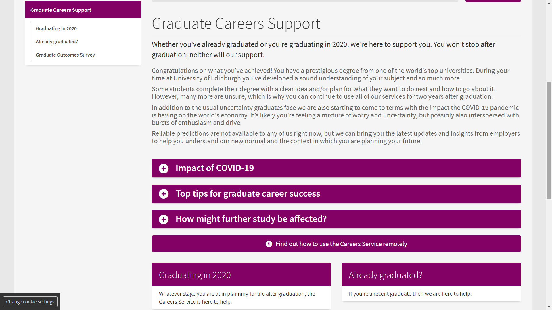
Graduating in 2020?
Specific new web pages for those of you graduating this year
https://www.ed.ac.uk/careers/graduate-careers-support

Slide 8
Look after yourself!
Take time to rest and look after yourself. The Student Association has tips on taking care of your mental health while self-isolating and social distancing
https://www.eusa.ed.ac.uk/yourvoice/ourwork/coronavirus/mentalhealth/

