Slide 1
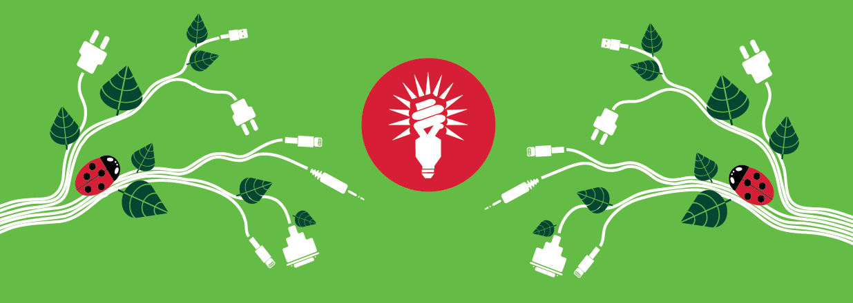
Energy Coordinator Summer meetup

Slide 2
Agenda, housekeeping
13.00 Networking lunch
13.25 Welcome
13.30 Energy Coordinator survey results
13.50 Estates update
14.15 Behavioural change 101
14.45 Wrap-up

Slide 3
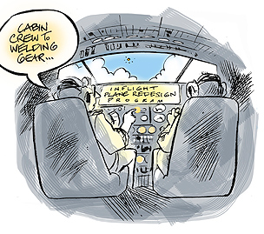
News
UK grid
Sustainable Campus Fund
  26 projects, £ 650,628 (84%)
  Savings: 1005 tCO2_{e} (over 1% or 500 New York flights)
  Savings: £ 212,600; 3.2 year payback
Next meetings
Notes:
My Uni tutor used to say that electric heating should be a criminal offence, but during a spell of nice weather with warmer, clear, windy days it meant fantastically high renewables uptake. For a few days, when renewables produced around 45% of electricity in UK, electric heating was better from an environmental perspective.
Overall, our CHPs are rapidly becoming the less sustainability preferred option, due to nationwide changes, however at the same time, it also means that less polluting power supply decreases our overall emissions.

Slide 4
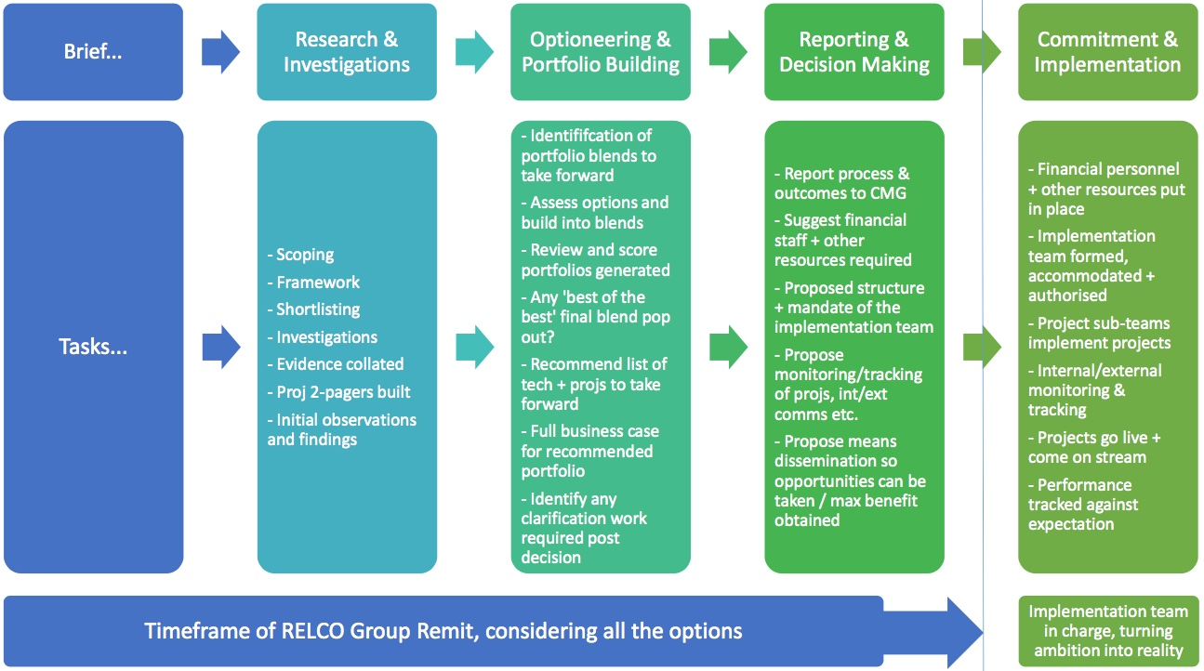
RELCO
Stage 2.5 out of 4
Initial shortlist complete
Finalising research and starting work on a portfolio
Staff and student consultations in May/June
Notes:
2040 Zero Carbon Strategy
Large scale PV 3rd cheapest source of electricity, onshore wind the cheapest
Securing future supplies – I’ve been on a presentation recently where a salesman said energy might cost 49p/kWh, which is too high, but shows the direction
Capitalise on opportunities – learning, teaching, research, reputation.
Group is making good progress, finalising research and starting building portfolio

Slide 5

Energy Coordinator Survey 2017
Results and what to improve
Mairi Kemp

Slide 6
Survey sample
Notes:
Sample size – surveyed 60% of Energy Coordinator network

Slide 7
Aims of the survey
Identify how Energy Coordinators are carrying out key tasks
(e.g. energy walkarounds, using SWITCH materials)
Assess the level of interest in student volunteer placements to help with energy walkarounds
Develop an understanding of drivers and barriers
Potential recruitment of new Energy Coordinators

Slide 8
Current energy walkaround practice

Slide 9
Student Volunteer help with energy audits

Slide 10
‘Are you clear about your role as an Energy Coordinator?’

Slide 11
Improvements to resources
Clearer guidelines on what is expected from the Energy Coordinator role
Potential roll-out of student volunteer placement to help with energy walkarounds
Materials for recruiting new energy coordinators
Refresh poster designs more regularly to keep people’s attention
Notes:
Guidelines – a list of duties has been written up and is now live on our website
Student volunteers – carried out a pilot of student help for walkarounds and now reviewing for long term roll out
Recruitment materials – short powerpoint slides to add into any staff meetings and a shareable webpage to get more people on board with saving energy
Posters – changes to design and colour of posters with seasonal inspiration will be taken into account
Any other suggestions – let us know!

Slide 12
What should the role of Energy Coordinator involve?
What is being an Energy Coordinator to you?
What resources and support would be useful?
Notes:
Bearing in mind the feedback from the survey (with 38% of Energy Coordinators not entirely clear on the role), discuss what the Energy Coordinator role is and what you expect from it.

Slide 13
Behaviour change 101
How to get folk to do things they don’t want to do
Notes:
Hi, there everyone, my name is Alan Peddie I work for SRS and work on the areas of waste and staff training.
A huge part of our work involves behaviour change where we want to make people change to behaviours that we would consider more sustainable or environmentally friendly.
So I am going to give you a little bit of background on ways we try to do this, some ideas, some techniques, some pitfalls and the hope is that it can give you guys some tools in order to get people to do things you want them to do.

Slide 14
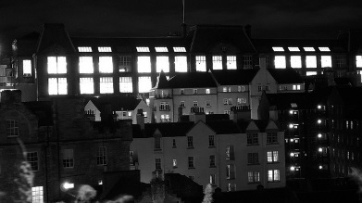
Why is it important?
Anywhere between 15-40% of emissions from behaviour
Notes:
There are a host of different reports and studies on the effects of behaviour change and depending on which report you read estimates can vary between 15-40% of carbon emission in households.
The implication from this is that we can surely have a big effect on our emissions, save energy, save money with positive behavioural changes.
Light picture from ECA

Slide 15
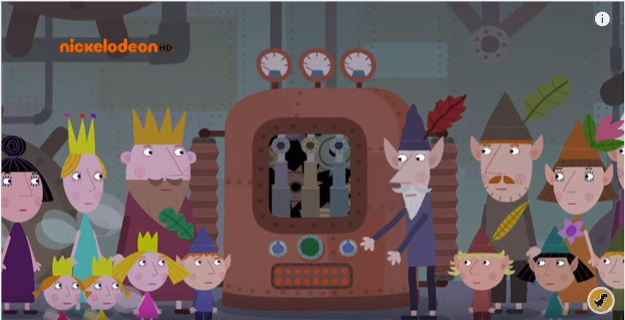
The good news
Environmental issues are mainstream now
Notes:
Time stamp from 7:40
So basically if environmental issues are part of kids cartoons I think we can safely say it is part of mainstream culture and thinking. Also you can replace magic as the fuel in this instance as the
Five years ago when I first started working at the Department people were a little interested but generally didn’t care
Now that may still be true but most people think all of the issues are accepted as the right thing to do
Don’t waste energy, stop using fossil fuels if we can, more people should cycle to work, we shouldn’t stick stuff in landfill etc
Bearing that in mind is a good starting point from big picture stuff like renewable energy all the way down to printing less paper

Slide 16
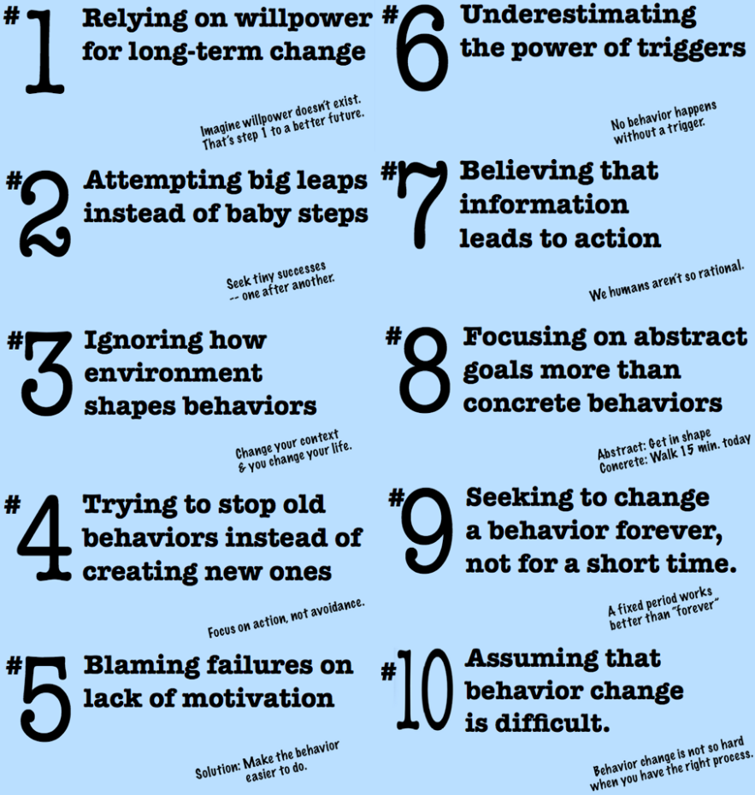
The bad news
Notes:
Let’s think about this from the bad end first so if we think about quitting smoking it is really easy to see how these things can be done

Slide 17
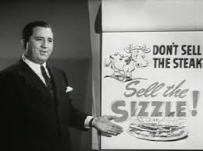
Marketing
Sell the benefits
Notes:
This is the idea that you sell the benefits of something rather than the thing itself. You sell the sizzle, not the steak.
When I say our sector, I mean sustainability in general, struggles a little in this respect. Primarily this is because generally the changes we want people to make result in them giving a thing up. Marketing tends to play up the benefits of the thing you are receiving.
You might not think exclusively you want the ingredients that combine to make awesome shampoo, you just want hair like Kim Kardashian.
In terms of sustainability we tend to talk about people cutting down or giving up something to act more sustainably so we have distanced ourselves slightly for better or worse. The benefits might be a bit more abstract, cleaner air, water, you cycle instead of using a car you can be healthier but it is more abstract and reliant on other factors.

Slide 18
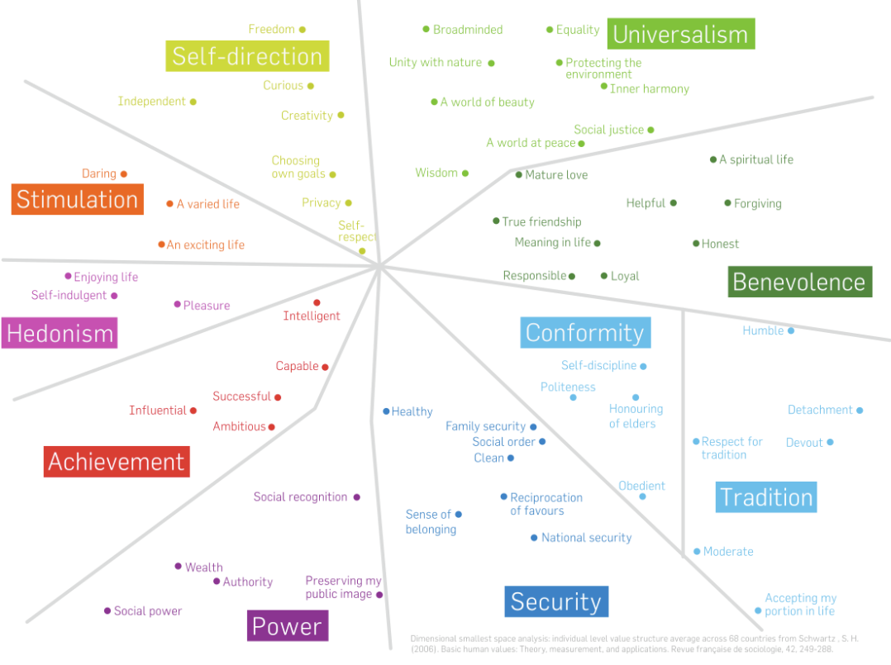
Values
Appeal to the person
Notes:
The Common Cause Handbook was a nice piece of work that came out of a non profit organization called the Public Interest Research Centre.
It essentially argues that in behaviour change we should appeal to people’s values as they are harder to change. So if someone is motivated by achievement or power then you may need to appeal to that to get someone to change their behaviour.
This idea has come under some criticism though as the impetus seems to be that if you are above this middle line you are good and below you are bad. We live in the real world so you have to work with the way people think, at least initially.
Someone at a presentation once said they didn’t believe in climate change but ordering less stuff was the right thing to do as too much was a waste.

Slide 19
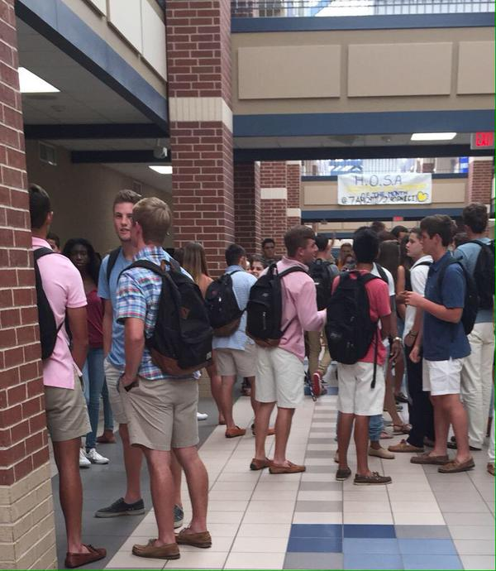
Community
Copying behaviour
Notes:
This is an idea posited by a chap called Doug McKenzie Mohr who argues for the idea that if a community acts in certain way it can impact upon others and make them act similarly.
The main crux of this idea does seem to bring up two main points 1) it seems to speak to the already engaged 2) it is about visibility.
Practically the work that we do in our Department is infinitely easier if someone in an area of the Uni (within that community) are making the change and are the visual representation of it. It is better to be participating that it is to be told what to do.
We have energy coordinators and they are representatives across building who are responsible for disseminating the information that they Energy Office pass out. Now it is impractical for one person in our office to do this and makes a bigger impact if a representative is someone from that community, policing energy use, putting up posters, stickers and helping drive any sustainable changes we would like to see.

Slide 20
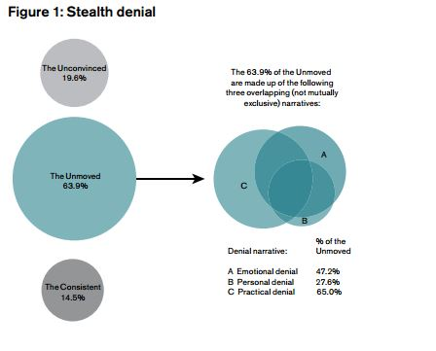
Ignorers
Do we care that they don’t care?
Notes:
Published late 2013. This is seemingly the next big challenge for people dealing with behaviour change.
Around 60% are climate ignorers. They may agree with the science and the sentiment but don’t act on it. This is a reality that needs to be faced and it is still unclear how this is going to be mitigated. The telegraph reported a poll stating that In Scotland 69 per cent of respondents agreed this was true that climate change was cause by human activity
My personal opinion is that if you can change infrastructure and culture around things these people will just go along with what the general public seems to be doing.

Slide 21
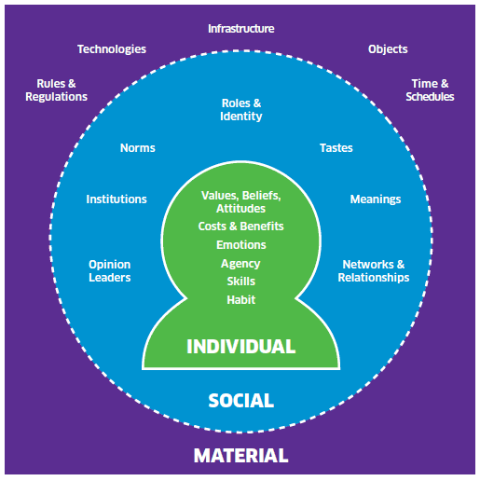
Individual Social Material
Context
Notes:
The ISM tool stands for Individual, Social, Material. It is an appreciation of the different contexts that can effect peoples behavior.
So Individual can mean values or emotions. Social, network and relationships. Material, infrastructure.
It is a very logical method of framing behaviour and can really help work out why people do what they do and why they might not act in a way you perhaps want them too.
From my experience of working at the Uni lots of people may want to act sustainably but they may not have the social or material aspects in place to do so. Whereas some people who might not even agree with climate change may just act sustainably as a by product of the other factors in their workplace like the social and material.

Slide 22
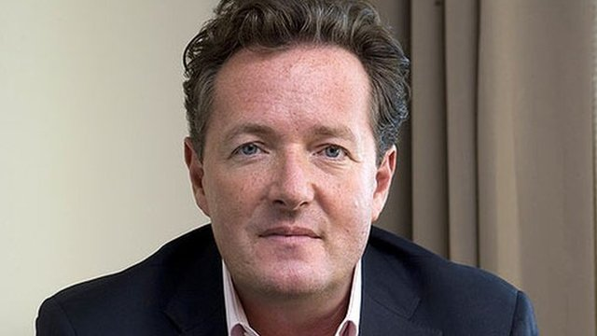
Annoy people
Notes:
Tell the story about the anti raffle
I was told a story about a raffle at Derby University, they gave people a chocolate on a random day to people who had left for lunch and turned off the computer and crucially

Slide 23
Conclusion
Steal the good stuff
Change the culture and people will follow
Do what works for your area and your people

Slide 24
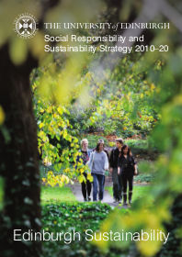
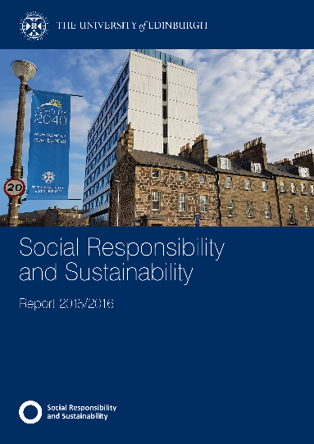

Questions?
Alan.Peddie@ed.ac.uk
www.ed.ac.uk/sustainability
Notes:
We do some time to feedback and you can catch me on the break but if there are any burning questions, feel free to ask

Slide 25
Questions?
Chris.litwiniuk@ed.ac.uk
www.ed.ac.uk/sustainability
Notes:
We do some time to feedback and you can catch me on the break but if there are any burning questions, feel free to ask

