Slide 2
Afghanistan
Kabul

Slide 3
Albania
Tirana

Slide 4
Algeria
Algiers

Slide 5
Andorra
Andorra la Vella

Slide 6
Angola
Luanda

Slide 7
Antigua and Barbuda
Saint John's

Slide 8
Argentina
Buenos Aires

Slide 9
Armenia
Yerevan

Slide 10
Australia
Canberra

Slide 11
Austria
Vienna

Slide 12
Azerbaijan
Baku

Slide 13
Bahamas
Nassau

Slide 14
Bahrain
Manama

Slide 15
Bangladesh
Dhaka

Slide 16
Barbados
Bridgetown

Slide 17
Belarus
Minsk

Slide 18
Belgium
Brussels

Slide 19
Belize
Belmopan

Slide 20
Benin
Porto Novo

Slide 21
Bhutan
Thimphu

Slide 22
Bolivia
Sucre

Slide 23
Bosnia and Herzegovina
Sarajevo

Slide 24
Botswana
Gaborone

Slide 25
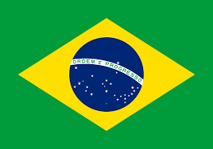
Brazil
Brasilia

Slide 26
Brunei
Bandar Seri Begawan

Slide 27
Bulgaria
Sofia

Slide 28
Burkina Faso
Ouagadougou

Slide 29
Burundi
Bujumbura

Slide 30
Cambodia
Phnom Penh

Slide 31
Cameroon
Yaoundé

Slide 32
Canada
Ottawa

Slide 33
Cape Verdi
Praia

Slide 34
Central African Republic
Bangui

Slide 35
Chad
N'Djamena

Slide 36
Chile
Santiago

Slide 37
China
Beijing

Slide 38
Columbia
Bogota

Slide 39
Comoros
Moroni

Slide 40
Costa Rica
San José

Slide 41
Croatia
Zagreb

Slide 42
Cuba
Havana

Slide 43
Cyprus
Nicosia

Slide 44
Czech Republic
Prague

Slide 45
Democratic Republic of the Congo
Kinshasa

Slide 46
Denmark
Copenhagen

Slide 47
Djibouti
Djibouti

Slide 48
Dominica
Roseau

Slide 49
Dominican Republic
Santo Domingo

Slide 50
East Timor
Dili

Slide 51
Ecuador
Quito

Slide 52
Egypt
Cairo

Slide 53
El Salvador
San Salvador

Slide 54
England
London

Slide 55
Equatorial Guinea
Malabo

Slide 56
Eritrea
Asmara

Slide 57
Estonia
Tallinn

Slide 58
Eswatini
Mbabane

Slide 59
Ethiopia
Addis Ababa

Slide 60
Fiji
Suva

Slide 61
Finland
Helsinki

Slide 62
France
Paris

Slide 63
Gabon
Libreville

Slide 64
Gambia
Banjul

Slide 65
Georgia
Tbilisi

Slide 66
Germany
Berlin

Slide 67
Ghana
Accra

Slide 68
Greece
Athens

Slide 69
Grenada
Saint George's

Slide 70
Guatemala
Guatemala City

Slide 71
Guinea
Conakry

Slide 72
Guinea-Bissau
Bissau

Slide 73
Guyana
Georgetown

Slide 74
Haiti
Port-au-Prince

Slide 75
Honduras
Tegucigalpa

Slide 76
Hungary
Budapest

Slide 77
Iceland
Reykjavík

Slide 78
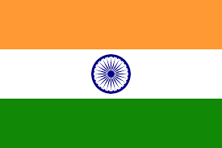
India
New Delhi

Slide 79
Indonesia
Jakarta

Slide 80
Iran
Tehran

Slide 81
Iraq
Baghdad

Slide 82
Ireland
Dublin

Slide 83
Israel
Jerusalem

Slide 84
Italy
Rome

Slide 85
Ivory Coast
Yamoussoukro

Slide 86
Jamaica
Kingston

Slide 87
Japan
Tokyo

Slide 88
Jordan
Amman

Slide 89
Kazakhstan
Astana

Slide 90
Kenya
Nairobi

Slide 91
Kiribati
Tarawa

Slide 92
Kosovo
Pristina

Slide 93
Kuwait
Kuwait City

Slide 94
Kyrgyzstan
Bishkek

Slide 95
Laos
Vientiane

Slide 96
Latvia
Riga

Slide 97
Lebanon
Beirut

Slide 98
Lesotho
Maseru

Slide 99
Liberia
Monrovia

Slide 100
Libya
Tripoli

Slide 101
Liechtenstein
Vaduz

Slide 102
Lithuania
Vilnius

Slide 103
Luxembourg
Luxembourg

Slide 104
Madagascar
Antananarivo

Slide 105
Malawi
Lilongwe

Slide 106
Malaysia
Kuala Lumpur

Slide 107
Maldives
Malé

Slide 108
Mali
Bamako

Slide 109
Malta
Valletta

Slide 110
Marshall Islands
Majuro

Slide 111
Mauritania
Port Louis

Slide 112
Mauritius
Port Louis

Slide 113
Mexico
Mexico City

Slide 114
Micronesia
Palikir

Slide 115
Moldova
Ulaanbaatar

Slide 116
Monaco
Monaco

Slide 117
Mongolia
Ulaanbaatar

Slide 118
Montenegro
Podgorica

Slide 119
Morocco
Rabat

Slide 120
Mozambique
Maputo

Slide 121
Myanmar
Naypyidaw

Slide 122
Namibia
Windhoek

Slide 123
Nauru
Yaren

Slide 124
Nepal
Kathmandu

Slide 125
Netherlands
Amsterdam

Slide 126
New Zealand
Wellington

Slide 127
Nicaragua
Managua

Slide 128
Niger
Niamey

Slide 129
Nigeria
Abuja

Slide 130
North Korea
Pyongyang

Slide 131
North Macedonia
Skopje

Slide 132
Northern Ireland
Belfast

Slide 133
Norway
Oslo

Slide 134
Oman
Muscat

Slide 135
Pakistan
Islamabad

Slide 136
Palau
Melekeok

Slide 137
Palestine State
East Jerusalem

Slide 138
Panama
Panama City

Slide 139
Papua New Guinea
Port Moresby

Slide 140
Paraguay
Asunción

Slide 141
Peru
Lima

Slide 142
Philippines
Manila

Slide 143
Poland
Warsaw

Slide 144
Portugal
Lisbon

Slide 145
Qatar
Doha

Slide 146
Republic of the Congo
Brazzaville

Slide 147
Romania
Bucharest

Slide 148
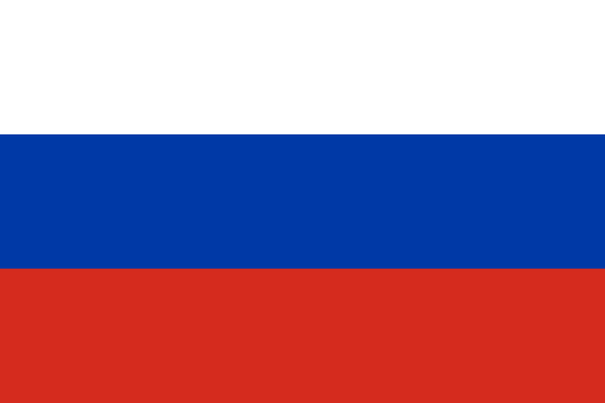
Russia
Moscow

Slide 149
Rwanda
Kigali

Slide 150
Saint Kitts and Nevis
Basseterre

Slide 151
Saint Lucia
Castries

Slide 152
Saint Vincent and the Grenadines
Kingstown

Slide 153
Samoa
Apia

Slide 154
San Marino
San Marino

Slide 155
Sao Tome and Principe
São Tomé

Slide 156
Saudi Arabia
Riyadh

Slide 157
Scotland
Edinburgh

Slide 158
Senegal
Dakar

Slide 159
Serbia
Belgrade

Slide 160
Seychelles
Victoria

Slide 161
Sierra Leone
Freetown

Slide 162
Singapore
Singapore

Slide 163
Slovakia
Bratislava

Slide 164
Slovenia
Ljubljana

Slide 165
Solomon Islands
Honiara

Slide 166
Somalia
Mogadishu

Slide 167
South Africa
Pretoria

Slide 168
South Korea
Seoul

Slide 169
South Sudan
Juba

Slide 170
Spain
Madrid

Slide 171
Sri Lanka
Sri Jayewardenepura Kotte

Slide 172
Sudan
Khartoum

Slide 173
Suriname
Paramaribo

Slide 174
Sweden
Stockholm

Slide 175
Switzerland
Bern

Slide 176
Syria
Damascus

Slide 177
Taiwan
Taipei

Slide 178
Tajikistan
Dushanbe

Slide 179
Tanzania
Dodoma

Slide 180
Thailand
Bangkok

Slide 181
Togo
Lomé

Slide 182
Tonga
Nukualofa

Slide 183
Trinidad and Tobago
Port of Spain

Slide 184
Tunisia
Tunis

Slide 185
Turkey
Ankara

Slide 186
Turkmenistan
Ashgabat

Slide 187
Tuvalu
Funafuti

Slide 188
Uganda
Kampala

Slide 189
Ukraine
Kiev

Slide 190
United Arab Emirates
Abu Dhabi

Slide 191
United States of America
Washington DC

Slide 192
Uruguay
Montevideo

Slide 193
Uzbekistan
Tashkent

Slide 194
Vanuatu
Port Vila

Slide 195
Vatican City
Vatican City

Slide 196
Venezuela
Caracas

Slide 197
Vietnam
Hanoi

Slide 198
Wales
Cardiff

Slide 199
Yemen
Sana'a

Slide 200
Zambia
Lusaka

Slide 201
Zimbabwe
Harare

Slide 202
www.justgiving.com/universityofedinburgh

