Slide 1
The U of E CMALT applicants group Core Areas 3, 4 and Specialist Area
ALT CC BY
Susan Greig
Educational Design & Engagement
Learning Teaching and Web Division
Information Services
This work is licensed under a Creative Commons Attribution 4.0 International License.
© Susan Greig, University of Edinburgh 2019 CC BY

Slide 2
Session Plan
10.00 – Welcome, help yourself to refreshments
10.10 – Introductions
10.20 – Core Area 3: The Wider Context
10:40 – Writing Break (10 minutes)
10:50 – Pair discussion of your writing
11:00 – Core Area 4: Communication and working with others
11:10 – Writing Break (10 minutes)
11:20 – Pair discussion of your writing
11:30 – Specialist Options
11:40 – Writing Break (10 minutes)
11:50 – Pair discussion of your writing
12:00 - Close

Slide 3
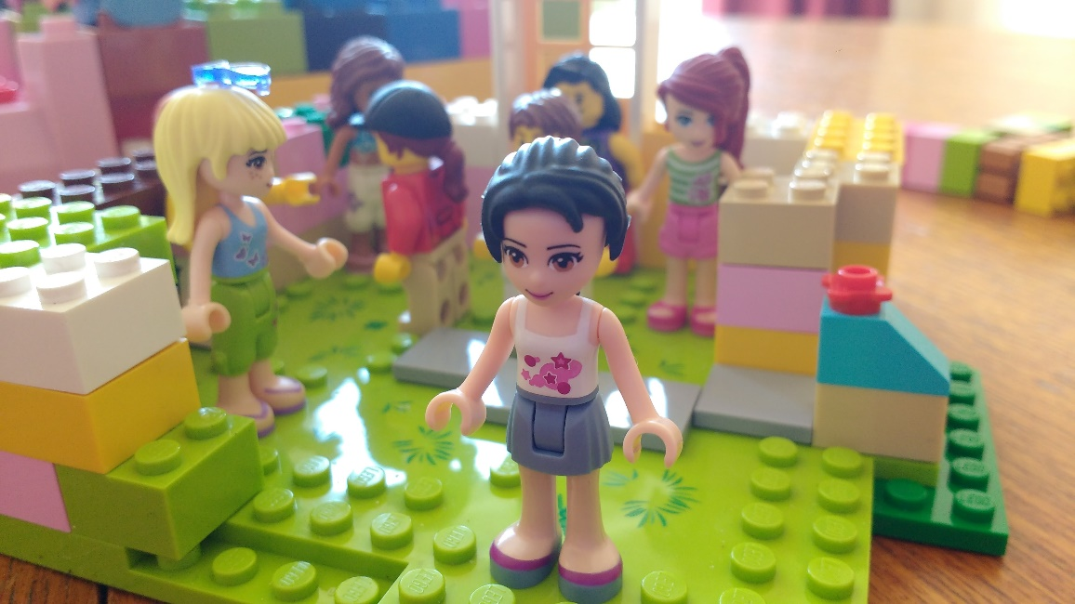
Introductions
Your Name
Your department
How (and when) are you finding the time to complete your CMALT portfolio?
Have you any questions you’d like answered today?
Susan Greig Introductions CC BY 2.0

Slide 4
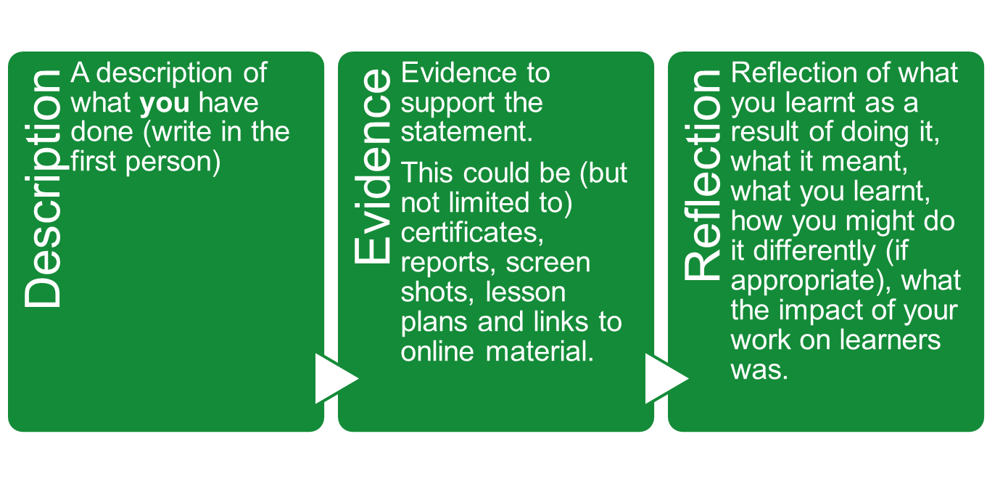
For each section you must provide:
A description of what you have done;
Evidence to support this;
Reflection on what you learnt as a result of doing it.
Image © Association for Learning Technology (ALT) Creative Commons Attribution-ShareAlike 4.0 (CC BY-SA 4.0) licence Source here

Slide 5
Evidence
You must include evidence to support a statement, directly within the portfolio, or in a numbered appendix, or as a link.
Certificate
Publication
Link to a piece of work
Evidence should be brief and well chosen - A page and a half or up to 500 words in support of each area.
You can cross reference to evidence from different sections of the portfolio.

Slide 6
Core area 3: The Wider Context
Candidates should demonstrate their awareness of and engagement with wider issues that inform their practice. Candidates must cover at least one legislative area and either a second legislative area or a policy area.
That is you need to cover a minimum of two areas, at least one of which must be legislative.
https://www.alt.ac.uk/sites/alt.ac.uk/files/assets_editor_uploads/CMALTGuidelines0416GoogleDoc_1.pdf

Slide 7
Core area 3: The Wider Context
Understanding and engaging with legislation, policies and standards
Statements here should show how relevant legislation, has influenced your work. You are not expected to have expert knowledge of all of these areas, but are expected to be aware of how they relate to your current practice.
In the UK you would be expected to demonstrate how you work within the context of relevant legislation such as:
Accessibility including special educational needs
Intellectual property (IPR)
Freedom of Information (if you work for a public body)
Data protection.
Child protection
Anti-discrimination law
Points Based Immigration System (PBIS)
Other related examples
In your country there may be different requirements, and you should indicate this in your portfolio. It is suggested that you pick at least two areas to discuss.

Slide 8
Core area 3: The Wider Context
b) Policy
You are not obliged to address this area so long as you have addressed at least two legislative areas. Examples of policy issues you may address include:
Policies and strategies (national or institutional)
Technical standards
Professional codes of practice
You might also be expected to engage with institutional policies and, where appropriate, national policies and evidence of some of this should be provided.
The kinds of evidence that would support this would include minutes of meetings with legal advisers, documentation showing how legal issues have influenced work (such as reports or data protection forms), justifications for modifications to a course to reflect new policies or a record of how technical standards have been taken into account during system development.
https://www.alt.ac.uk/sites/alt.ac.uk/files/assets_editor_uploads/CMALTGuidelines0416GoogleDoc_1.pdf

Slide 9
Writing Break
Think about your own experience:
note down what you might include under each of the two headings:
Core area 3: The Wider Context
Understanding and engaging with legislation, policies and standards
Policy (or choose a 2nd piece of legislation)
Diary Writing by Fredrik Rubensson CC BY-SA 2.0

Slide 10
Core area 4: Communicating and working with others
Candidates should demonstrate their knowledge and skills in communication through working with others.
Statements could describe the way in which your work involves collaboration, for example through participation in a team or acting as an interface to other groups.
Relevant evidence would include reflection on collaborations with others, reports outlining your activity within a team process, how you have brokered support for a particular initiative (for example from a technical or legal support service) or how you have worked with others to solve problems.
Where your evidence involved collaboration, please acknowledge the contribution of others. You may also chose to discuss how you select appropriate forms of communication.
https://www.alt.ac.uk/sites/alt.ac.uk/files/assets_editor_uploads/CMALTGuidelines0416GoogleDoc_1.pdf

Slide 11
Certified Membership of the Association for Learning Technology - CMALT
ALT Principles and values
“Learning technology is the broad range of communication, information and related technologies that can be used to support learning, teaching, and assessment.”
The principles and values that inform the development of the scheme are:
A commitment to exploring and understanding the interplay between technology and learning.
A commitment to keep up to date with new technologies.
An empathy with and willingness to learn from colleagues from different backgrounds and specialist options.
A commitment to communicate and disseminate effective practice.
https://www.alt.ac.uk/certified-membership https://www.alt.ac.uk/membership/membership-benefits

Slide 12
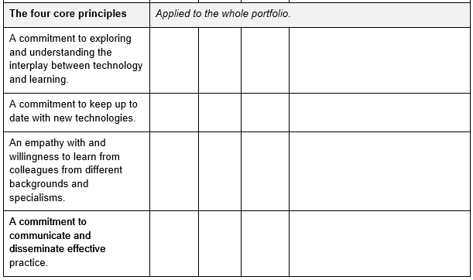

Slide 13
Writing Break
Think about your own experience:
note down what you might include for:
Core area 4: Communicating and working with others
Also consider addressing:
An empathy with and willingness to learn from colleagues from different backgrounds and specialisms.
A commitment to communicate and disseminate effective practice.
Diary Writing by Fredrik Rubensson CC BY-SA 2.0

Slide 14
Core area: Specialist Option(s)
As well as the core areas, candidates are required to demonstrate evidence of independent practice in one or more specialist options. This reflects the fact that, although there are common areas of work for learning technologists, practice is extremely diverse and everyone specialises in something different.
Your specialist topic should reflect an area where you have particular expertise. This may be unique to you or common across your team, but goes beyond what would be expected of any learning technologist. Below is an indicative list of possible specialist options. You are free to choose from it, or to select a different area that reflects your expertise.
https://www.alt.ac.uk/sites/alt.ac.uk/files/assets_editor_uploads/CMALTGuidelines0416GoogleDoc_1.pdf

Slide 15
Core area 3: Specialist Option(s)
producing learning materials/content/courseware;
project management, including resource management, in learning technology;
training, mentoring and developing others;
evaluation;
research;
management/administration of a sustainable e-learning process;
supporting and tutoring learners;
designing tools and systems;
institutional development/strategic work;
knowledge and application of emerging standards for learning technology;
https://www.alt.ac.uk/sites/alt.ac.uk/files/assets_editor_uploads/CMALTGuidelines0416GoogleDoc_1.pdf

Slide 16
assistive technologies;
VLE administration and maintenance;
interface design;
distance learning/blended learning;
managing and sourcing content;
copyright;
learner support;
accessibility;
sustainability
inclusive learning practice
open education resources (OER)
MOOCs

Slide 17
Defining and evidencing your specialist option
In describing your specialist option you should refer to the values listed at the top of these guidelines. Because these are specialist options you should be clear what makes your work distinct from common practice; many people teach on online courses, but designing and delivering fully online courses requires specific skills and would be considered specialist. . Similarly, many teachers provide blended learning, but developing and sharing guidelines for such practice or working with a distinctive blend of contexts might distinguish your work as specialist. It may be that your specialist option is common amongst the group that you work in as you all work in a similar area; that is perfectly acceptable.
Evidence for your specialist activity is likely to be very specific but could include: reports, papers or presentations you have written; this could be backed up by a job description plus written statements supporting your specialist knowledge from colleagues, clients or managers; active membership of professional or other bodies; certificates of completion of specialist training programmes or courses.

Slide 18
Writing Break
Think about your own experience:
note down what you might include for your:
Specialist Option
Diary Writing by Fredrik Rubensson CC BY-SA 2.0

Slide 19
Reflection prompt questions:
What have I learnt from doing what I described above?
What went well/ what could have gone better?
What would I do differently another time?
What was the impact on my users/students/learning?
Reflection Davide D’Amico CC BY-SA 2.0

Slide 20
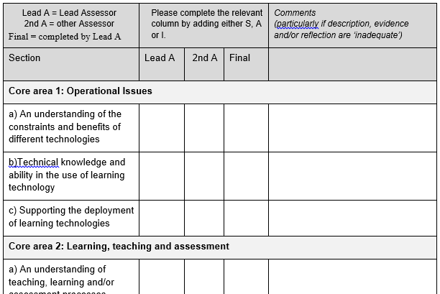
Assessment Form
https://www.alt.ac.uk/certified-membership/cmalt-support

Slide 21
Next Events:
Event details
Event details
Event details
Distance Timothy Vogel CC BY-NC 2.0

Slide 22
This work is licensed under a Creative Commons Attribution 4.0 International License.
© Susan Greig, University of Edinburgh 2019 CC BY

