Slide 1
Breaking news from IST-3
Peter Sandercock
University of Edinburgh
on behalf of the IST-3 collaborative group
ESC London
29th May 2013
Notes:
1

Slide 2
Disclaimer & disclosures
I will present relevant data from current research and there may be data or statements not covered by current regulatory approval. This presentation does not suggest clinical use beyond regulatory approval.
Please always check the most current prescribing information as approved for your country.
IST-3 was conducted completely independently. BI donated drug and placebo for the first 300 patients in IST-3 and thereafter made no financial contribution, & had no role in data collection, analysis, reporting or the decision to publish.
IST-3 disclosures in full in Lancet publication

Slide 3
Outline
IST-3 main features
Predicting early risk (SICH < 7 days) and benefit at 6 months.
Longer-term outcomes;18 months (in press, Lancet Neurology)
Survival
Functional status (OHS) & quality of life
Living at home, institution
What’s still to come?

Slide 4
Main features of IST - 3
Prospective, randomised, open, controlled study of i.v. rt-PA vs control,
3035 acute ischaemic stroke < 6 hours, 95% did not meet terms of EU approval, 54% aged > 80yrs
Primary outcome at 6 months: Oxford Handicap Scale (OHS) : % ‘alive and independent’ (OHS 0-2)
Secondary outcomes at 18 months: death, OHS, HRQoL, Living circumstances
Notes:
4

Slide 5
Demands for subgroups!
Dear Mr. Sandercock. I am writing you concerning IST-3. In IST-3, patients with previous stroke >14 days got included, to my knowledge.
How many patients were included in the study, which showed a previous stroke >14 days but < 3 months? (answer: n= 699)
Were these patients with a previous stroke >14 days but < 3 months analyzed separately in a subgroup analysis? If yes, how were the outcome parameters (including sICH)? Dr XXXX, XXX.

Slide 6
Risks, benefit and interactions in IST-3. For each subgroup consider:
early RISK = excess risk of symptomatic ICH < 7 days
net BENEFIT = at 6 months, shift in OHS grade in an ordinal analysis

Slide 7
SICH < 7d
Ordinal OHS at 6 mo.

Slide 8
Need a larger dataset…
= individual patient data meta-analysis of all the i.v. rt-PA trials

Slide 9
Randomised controlled trial data for iv rt-PA on 6756 patients,

Slide 10
Data exchange between BI and IST3

Slide 11
STTC analysis plan
Primary analyses:
After what treatment delay is benefit lost or does harm begin?
Do age or stroke severity modify the proportional effect of rt-PA on stroke outcome?
Secondary analyses
Effect of treatment allocation on: death within 90 days, SICH?
Effect modification by other baseline characteristics?

Slide 12
Long-term outcome
cNeurology 2013
(in Press)

Slide 13
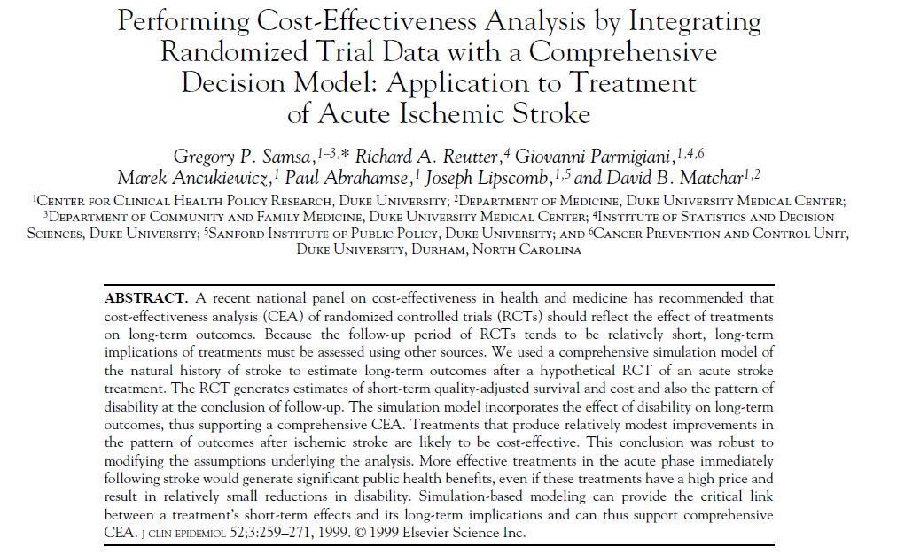
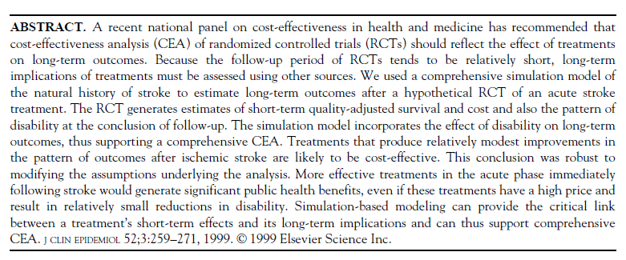

Slide 14
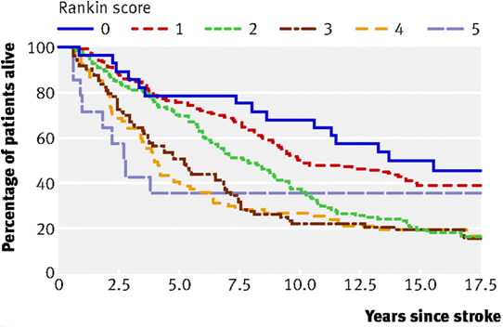
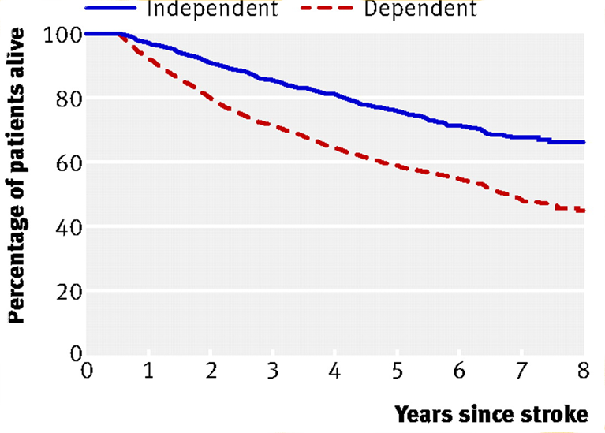
Epidemiology: level of function at six months (mRS or dependency) after stroke predicts long-term survival
OCSP
IST-1 UK
Slot K B et al. BMJ 2008;336:376-379
Notes:
Fig 1 Oxfordshire cohort. Long term survival of patients in each category of functional status (Rankin score 0-5) from assessment at six months after index stroke

Slide 15
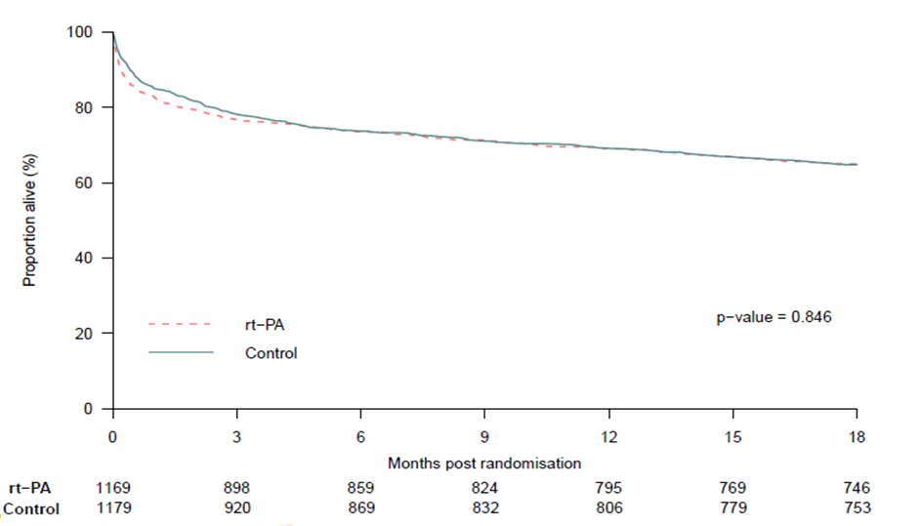
IST-3: survival to 18 months

Slide 16
At 18 months, % ‘alive & independent’ (OHS 0-2)
rt-PA (n=1169)* |  | control (n=1179)*
n | (%) | n | (%)
391 | (35%) | 352 | (31%)
Adjusted odds ratio 1.28
(95% CI 1.03 -1.57) p = 0.024
= 36/1000 more alive and independent
*N= 2248 patients in 18-month follow-up cohort

Slide 17
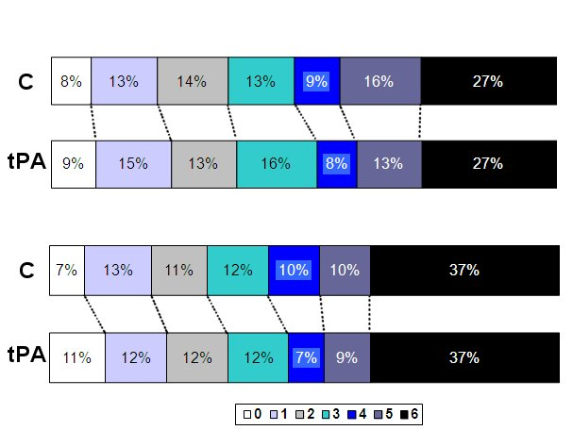
Ordinal 6 months p=0·001
Ordinal 18 months p= 0.002

Slide 18
At 18 months, % of survivors living at home
rt-PA (n=709) |  | control (n=707)
n | (%) | n | (%)
574 | (81%) | 553 | (78%)
Adjusted odds ratio OR=1·32,
(95% CI 1·00 to 1·73) p = 0·05

Slide 19
IST-3: still to come
Imaging: Auditorium Thursday 12:20.
Wardlaw. IST-3: Does perfusion imaging lesion size or mismatch influence six month outcomes after rt-PA given up to six hours after acute ischaemic stroke?
Risk and benefit: Room 17 Thursday 17:00. Whiteley. IST-3: Predictions of intracranial haemorrhage and the risks and benefits of rt-PA in acute ischaemic stroke
Health economic analysis

Slide 20
Plans for longer-term follow-up
Deaths on all UK patients from office of National Statistics
Death data for Norway and Sweden from National Registries of Deaths
Questions:
In the IST-3 cohort, does OHS at six months predict long-term survival?
Does the ‘shift in level of function’ with rt-PA translate into long-term survival differences?

Slide 21
Take home messages
Pre-treatment antiplatelet & higher NIHSS -> higher SICH risk, but benefit NOT reduced
Risk of SICH with rt-PA is NOT time-dependent, but benefit IS
STTC will provide reliable evidence on factors modifying SICH risk & response to treatment
Long-term outcome is important: benefits of thrombolysis are still evident at 18 months
Even modest gains in function may translate to long-term survival benefit – longer FU ongoing

Slide 22
Acknowledgements:
The 3035 patients, 156 hospitals in the IST-3 group, 12 National Coordinators, Data Monitoring Committee, MRC Steering Committee, Image Reading Panel, Event adjudication panel,.
Notes:
22

