Slide 1



Back to the future: Precision Medicine
6 May, 2016
Anna Dominiczak
Regius Professor of Medicine
Vice Principal & Head of College of Medical
Veterinary & Life Sciences

Slide 2





Generation Scotland:
the Scottish Family Health Study
Anna Dominiczak
on behalf of the Study Team

Slide 3
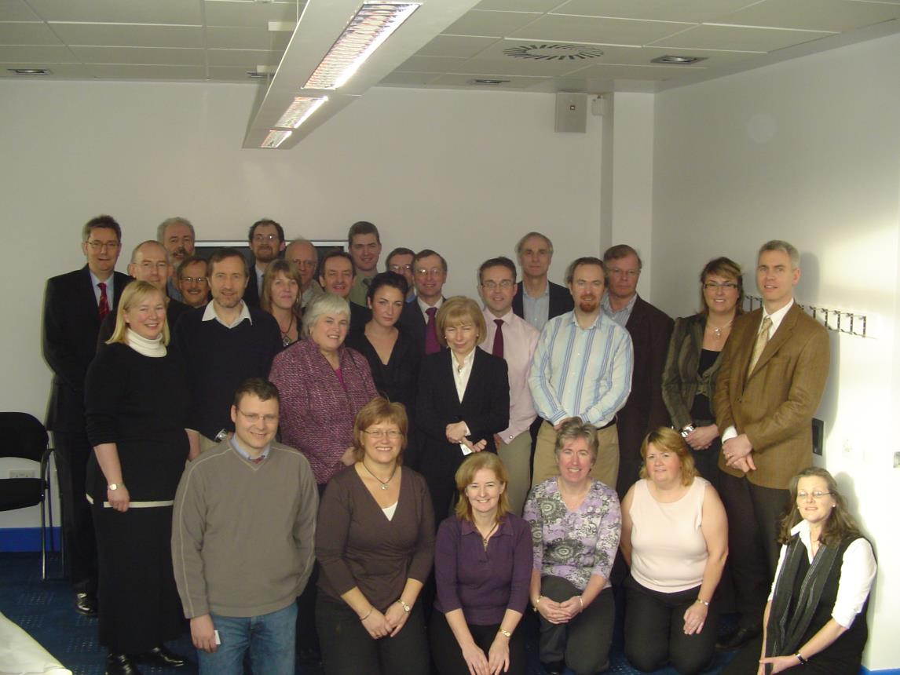
The team!

Slide 4
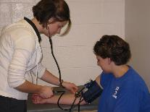
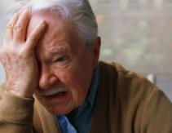
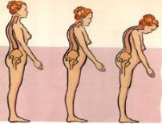

Research questions
Heart Disease
  Why does high blood pressure run in families?
  Who responds to cholesterol lowering drugs?
Mental Health
  Can we identify which patients
  with depression respond best to specific drugs?
Bone Disease
  Why does osteoporosis run in families?
  Which people with osteoporosis are most likely to suffer a fracture?
Adverse drug reactions
  Can we identify those people who may respond adversely to commonly prescribed drugs?

Slide 5
Precision or Stratified Medicine
Stratified (precision) medicine is based on identifying subgroups of patients with:
Distinct mechanisms of disease & particular responses to treatments
This allows us to identify and develop treatments that are effective for particular groups of patients
Ultimately precision medicine will ensure that the right patient gets the right treatment at the right time
UK Medical Research Council

Slide 6


Promise of Precision Medicine
Remove
Non-responders and toxic responders
Treat
Responders and Patients
not predisposed to toxicity

Slide 7

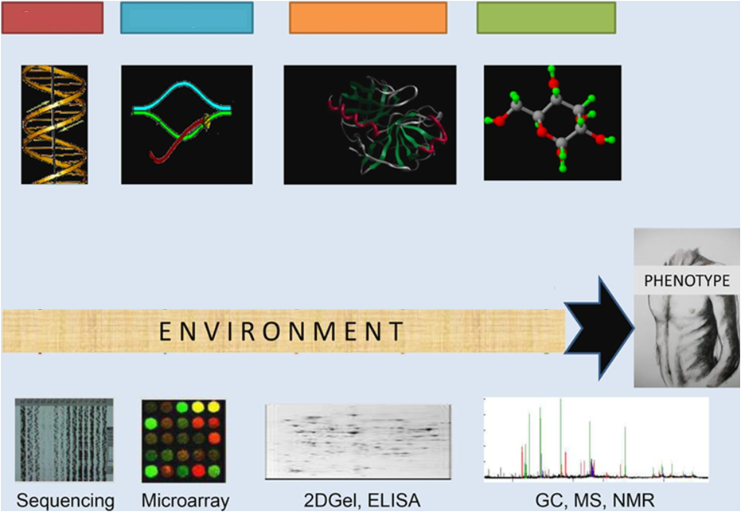

Omics technologies available for integrated analyses
Genome
Transcriptome
Proteome
Metabolome
Enzymes
DNA
N~2x10⁴
RNA
N~4x10⁴
Protein
N~10⁶
Metabolites
N~5x10³
Shah, and Newgard Circ Cardiovasc Genet. 2015;8:410
Notes:
Visual representation of omics technologies available for integrated analyses. Molecular changes reflected in these markers, in combination with environmental influences, result in the health or disease phenotype. GC indicates gas chromatography; MS, mass spectrometry; and NMR, nuclear magnetic resonance. Reprinted from Lewis et al²⁴ with permission of the publisher. Copyright © 2008, Elsevier.

Slide 8



















Stratified Medicine Scotland –
Innovation Centre
6 Exemplars: Ovarian, Oesophageal, Pancreatic Cancer,
Rheumatoid Arthritis, Multiple Sclerosis, IBD/COPD

Slide 9
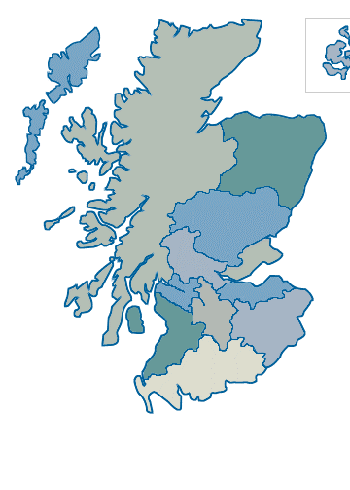







Exemplar 1 – Rheumatioid Arthritis
Involved:
  Prof Iain McInnes (UoG; PI)
  Dr Duncan Porter (GGHB)
  Prof Paul McKeigue (UoE)
  SMS-IC SMART Lab
  Sistemic
  ThermoFisher
  Aridhia
Delivers:
  Pharmacogenomic relationship for response/non response to methotrexate in RhA
Utility:
  Allows clinicians to prescribe MTX only in cases where evidence base predicts it will work
  Creates more compelling arguments for use of biological therapy in early RhA

Slide 10

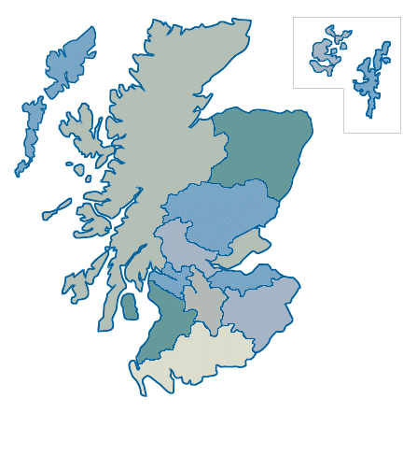



Exemplar 2 – oesophageal cancer
Involved:
  Prof Zosia Meidzybrodzka (UoA; PI)
  Dr Russell Petty (NHSGG&C)
  SMS-IC SMART Lab
  ThermoFisher
  Aridhia
Delivers:
  Pharmacogenomic relationship for response/non response to gefitinib (EGRR TK inhibitor) in OC based on a completed clinical trial
Utility:
  Would create evidence base for use of gefitinib in OC in pts with appropriate signature
  May drive future trials (label extensions for gefitinib and/or news EGFRTK agents)

Slide 11
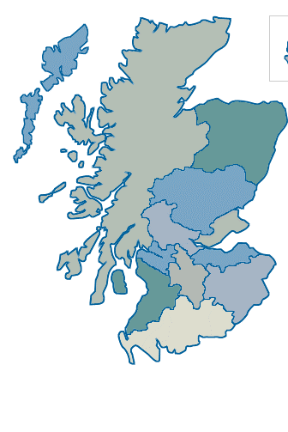






Exemplar 3 – ovarian cancer
Involved:
  Prof Charlie Gourley (UoE; PI)
  Prof Iain McNeish (UoG)
  NHST HB
  NHSG HB
  SMS-IC SMART Lab
  ThermoFisher
  Aridhia
Delivers:
  Identifies presence/absence of BRAC1/2 mutations in tumours of OC pts currently denied treatment with PARP inhibitors (olaparib).
Utility:
  Would create evidence base for use of PARP inhibitors in OC pts with somatic mutations (not just germline mutations)
  Treatment of 35% more OC pts with PARP inhibitors

Slide 12







Exemplar 5: FutureMS – Multiple Sclerosis
Involved:
  Prof Siddharthan Chandran (Anne Rowling Clinic; UoE; PI)
  4 Consultant Neurologists (NHST; NHSG, NHSGGC, NHSL)
  SMS-IC SMART Lab
  ThermoFisher
  Aridhia
  Fios Genomics
  Wellcome Trust CRF
Delivers:
  Evidence based decision making for prescription of DMTs where none currently exists
Utility:
  Allows clinicians to prescribe DMTs where they will have the maximum impact
  Creates opportunities for MS clinical trials using a national Scottish cohort

Slide 13





Drug Trials Get Smarter
Enrollment through centralized testing (old)
Rejected (Treatment Delayed)
No Mutation
OLD
Clinical Trial
agent targets
mutation A
Patient sample sent to CRO for genotyping
Enrolled
Mutation A
Patients with disease
Mutation B
Mutation A
Mutation D
Mutation C
Trial B
NGS Panel
Stratify patients
Trial A
NEW
Trial D
Enrollment through care-embedded testing (future)
Trial C
Modified from
Notes:
Talking Points:
Clinical trials going forward will enroll increasingly based on a known mutation which is associated with response to new targeted chemo agents
Don’t enroll patients blindly and wait for the pharma company to reject/accept based on the marker they are selecting on
Instead using sequencing can know ahead of time which mutations patients carry and thus RATIONALLY enroll them into clinical studies
Transition (if applicable):

Slide 14

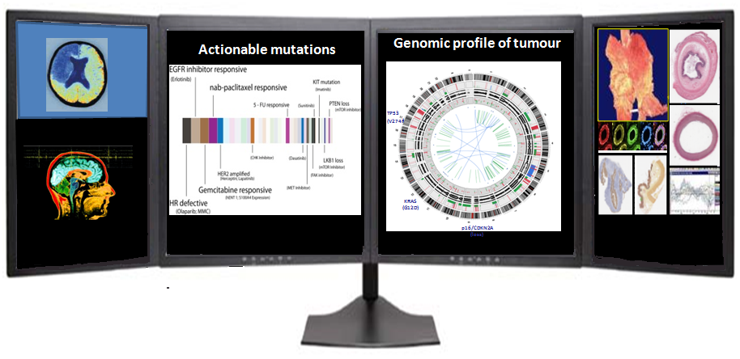
Long - term vision
  To transform management of chronic disease globally by accelerating biomedical research, high quality health care provision and economic growth
Modified from

Slide 15
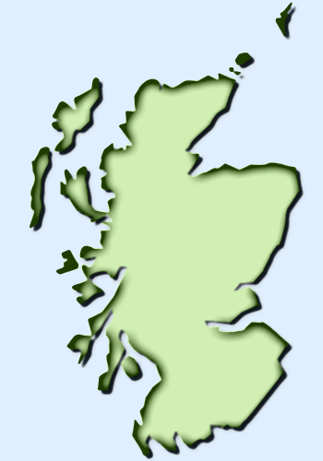












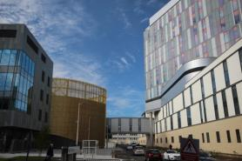
Scottish Ecosystem for Precision Medicine
Connected Ecosystem
Broad Industry Base
Data Integration and Analysis
Advanced Exemplars
Academic Leadership
Rapid NHS Adoption
Forward-thinking NHS
Diagnostics
Electronic Health Records
Clinical Trials
Commercial Products
Chronic Disease, Patient Trust
Fast Regulatory Approval
QEUH
illumina
& SGP
Two MRC Molecular Pathology Nodes

Slide 16

Cardiovascular Consequences of Pre-eclampsia Study (COPS)
Christian Delles et al,
Record linkage
Epidemiological approach
Women with history of preeclampsia 10-30 yrs ago
&
Women with history of normotensive pregnancy 10-30 yrs ago
Biobank
Biomarker studies
Recall of study participants
Vascular function studies

Slide 17
5th Consortium Meeting (Final)
26th & 27th April 2016
Glasgow, UK
FIMA: WP6- BIOMARKERS OF MYOCARDIAL REMODELLING
Task 6.3. Cross-sectional and prospective analysis
Generation Scotland Cohort: 205 subjects without previous HF at baseline, 45 of which had incidence of HF code (IC50_X) or CV death and 55 had incidence of HF code (IC50_X) or all-cause death (Gla, MOS, FIHCUV)
Biomarkers of myocardial remodelling
PICP, ng/ml
hs-cTnT, ng/l
NT-proBNP, pg/l
Cell adhesion array
VCAM-1, ng/ml
ICAM-1, ng/ml
ESEL, ng/ml
PSEL, ng/ml
LSEL, ng/ml
Cytokine array
IL6, pg/ml
IL8, pg/ml
IL10, pg/ml
VEGF, pg/ml
TNF-alpha, pg/ml
MCP1, pg/ml
EGF, pg/ml
Urinary Score
ACSP75
Metabolic Score
Metabolic score
Biomarker score: NT-proBNP, ICAM-1, TNF-alpha, ACSP75
1st tertile (<0.1415), n=68
2nd tertile (0.1415-0.2539), n=69
3rd tertile (>0.2539), n=68
5
HR (95%CI)= 5.4 (2.1-13.7), P<0.001
12
HR (95%CI)= 2.8 (1.0-7.3), P=0.04
10
HR (95%CI)= 5.2 (2.3-11.8), P<0.001
4
HR (95%CI)= 2.5 (1.0-5.9), P=0.04
8
3
6
2
Cumulative incidence of HF or all-cuase death (%)
Cumulative incidence of HF or CV death (%)
4
1
2
0
0
0
1
2
3
4
5
6
0
1
2
3
4
5
6
7
8
9
Time of follow up (years)
Time of follow up (years)
Confounding factors: Age, Na, eGFR, treatment with BB and AB
Notes:
ACSP75 associated with fatal and non-fatal events in the context of atherosclerosis
ICAM-inflammatory microvascular endothelial activation

Slide 18
How to support future work?
Develop an efficient system for pre-application enquiries
Available samples?
Number of participants with a certain phenotype/event?
Systematically explore and publish relevant endpoints
e.g. number of hospitalisations for CAD
e.g. number of participants developing CKD stage 3
e.g. total mortality
Make more and better use of opportunities to recall participants for further studies
based on genotype
based on a biomarker (already available or to be measured)
based on a phenotype (already available or through record linkage)

Slide 19

Thank you
www.stratmed.co.uk

Slide 20
5th Consortium Meeting (Final)
26th & 27th April 2016
Glasgow, UK
FIMA: WP6- BIOMARKERS OF MYOCARDIAL REMODELLING
Task 6.3. Cross-sectional and prospective analysis
Generation Scotland Cohort: 67 subjects with previous HF at baseline, 20 of which had hospitalization for HF code (IC50_X) or CV death (Gla, MOS, FIHCUV)
Biomarker score: NT-proBNP, ICAM-1, TNF-alpha, ACSP75
Biomarker-Score
NT-proBNP_125 pg/ml
1st tertile (<0.2122), n=22
2nd tertile (0.2122-0.4032), n=23
1st tertile (<125), n=21
3rd tertile (>0.4032), n=22
2nd tertile (>125), n=50
9
9
8
HR (95%CI)= 8.8 (1.7-46.4), P=0.01
8
HR (95%CI)= 1.2 (0.4-3.3), P=0.71
7
HR (95%CI)= 2.6 (0.5-13.4), P=0.25
7
6
6
5
5
4
4
Cumulative incidence of HF or CV death (%)
Cumulative incidence of HF or CV death (%)
3
3
2
2
1
1
0
0
0
1
2
3
4
5
0
1
2
3
4
5
Time of follow up (years)
Time of follow up (years)

Slide 21

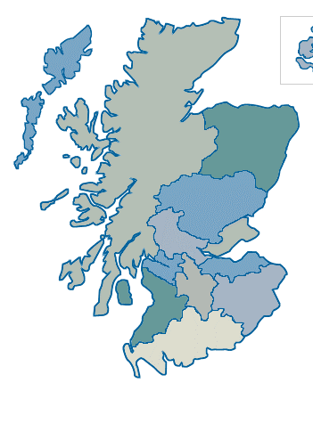








Exemplar 4 – IBD/COPD
Involved:
  Dr David Bunton (Biopta; PI)
  Ms Jane Hair (GG&CHB bio-repository)
  Prof Jack Satsangi (UoE)
  Prof Colin Palmer (UoD)
  FIOS Genomics
  SMS-IC SMART Lab
  ThermoFisher
  Aridhia
Delivers:
  Identifies genetic signature in IBD/COPD tissues predictive of response to positive control agents in in vitro pharmacology organoculture
Utility:
  Allows a commercial advantage and USP for Biopta – pt samples (blood) could be pre-screened for predicted response ahead of committing to organoculture (contract screening service for pharma/biotech)

Slide 22
The Clinical Genome
Genomics England plans to sequence 100,000 genomes by 2017
Recruit 75,000
people
Next Generation
Sequencing
Automated
Interpretation
Clinical
Interpretation
V. Marx, Nature 2015;524:503

Slide 23

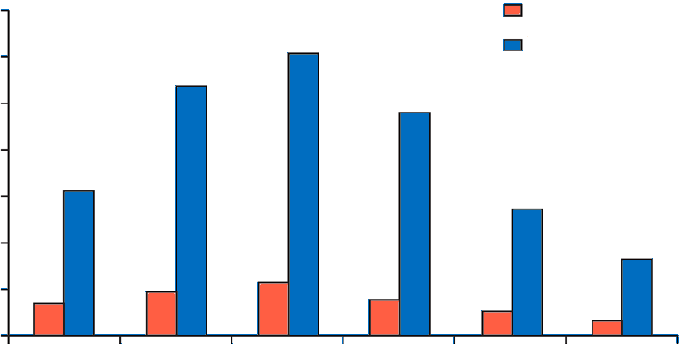
Value of health from hypothetical precision medicine prevention innovation in the USA
Cumulative value of additional quality-adjusted life-years generated
(2012-60, valued at US$100,000 each)
10% Incidence reduction
700
50% Incidence reduction
600
500
400
Value of health (US $billions)
300
200
100
0
Cancer
Diabetes
Heart Disease
Hypertension
Lung Disease
Stroke
Dzau VJ, Lancet 2015;385:2118-2119

