Slide 1
Interactive evidence maps
A potential tool to inform decision-making in LMICs?
Theodora Tsouloufi, Louise Donnison, Karen Smyth, Andrew Peters

Slide 2
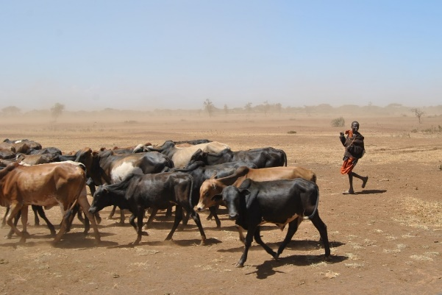
Livestock Evidence in LMICs
Livestock data are disparate and sometimes scarce
Diseases have multiple, heavy burdens with upward trends
25-40% of published evidence on zoonotic agents is of poor quality
Evidence synthesis difficult or not possible
https://pixabay.com/
Evidence synthesis difficult or not possible

Slide 3
The Need
Appropriate
Inclusive
“Good”
Evidence
Accessible
Transparent
https://www150.statcan.gc.ca
Validated
Rigorous

Slide 4
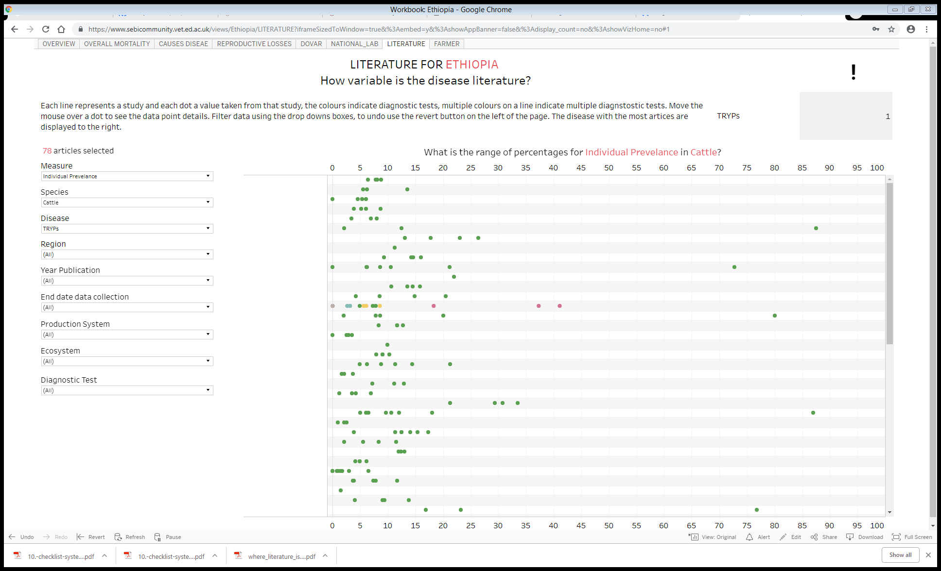
What is the disease frequency and mortality in Ethiopia?
Published & grey literature
Observational studies, 56 infectious diseases
High volume of studies (>300)-Tryps as top!
Quality assessment: The Joanna Briggs Institute Prevalence Critical Appraisal Tool (Munn et al 2014)

Slide 5
Interactive evidence maps
An open access, usable, interactive evidence database
Systematic map and rapid review methodology
Three-stage stakeholder engagement
-Scope
-Development
-Final output
Three projects ongoing:
- Disease frequency in Ethiopia
- Investigation of livestock mortality in LMICs
- Automation of systematic maps (Bayes Institute, Data Driven Innovation)
https://www.ed.ac.uk/bayes

Slide 6
Next steps
Expand to other countries and types of evidence (e.g. intervention impact, disease impact and productivity studies)
Increase engagement of stakeholders to maximize the relevance and usability of data
Incorporate automation in data collation for rapid and timely evidence
Livestockdata.org

