Slide 1
Mapping livestock feed options – a system level approach Alan Duncan^{1,4}, Simon Fraval², An Notenbaert³, John Mutua³, Philip Thornton⁴ University of Edinburgh Africa Week 25 Oct 2019 1. Global Academy of Agriculture and Food Security 2. Independent consultant. 3. CIAT. 4. International Livestock Research Institute

Slide 2
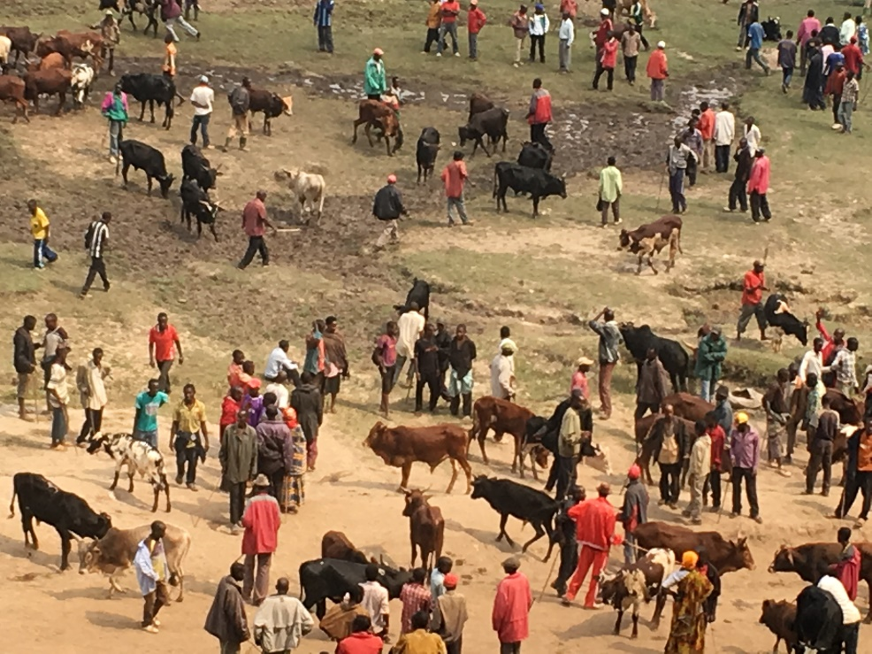
The Challenge
Livestock feed development efforts in Africa tend to promote new feeding strategies in a piecemeal fashion without sufficient consideration of:
System level constraints (land, labour, markets)
Core feed constraints (lack of biomass, poor quality feed, seasonal scarcity).

Slide 3
Fitting options to context
Technical feed options
Farming system
?
?
?
?
?
?

Slide 4
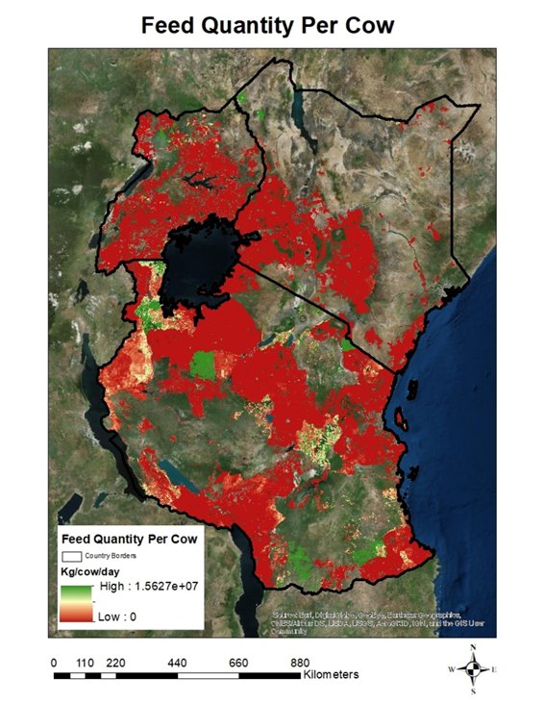
Mapping system characteristics to predict where different feed options will work
Prototype map of E Africa showing feed biomass per cow using
NDVI and land cover data to estimate biomass
Gridded Livestock of the World data for livestock density estimates
Examples of feed options to mitigate biomass scarcity
Intensive grass production
Short-duration / annual fodder crops (e.g. Oats, maize, sorghum, vetch)
Irrigated fodder production (grasses, maize, sorghum)
Mercy Fakude, MSc thesis, 2018

Slide 5
Next steps
Feed seasonality: Lushoto, Tanzania
(Number of consecutive days (30% less than growing period mean)
Maps of core feed issues (overall feed availability, seasonal feed availability, overall feed quality)
Maps of adoption factors (land, labour, water and market access)
Feasibility surfaces for candidate feed options e.g. grass hay, planted grasses, irrigated forage, forage trees

Slide 6
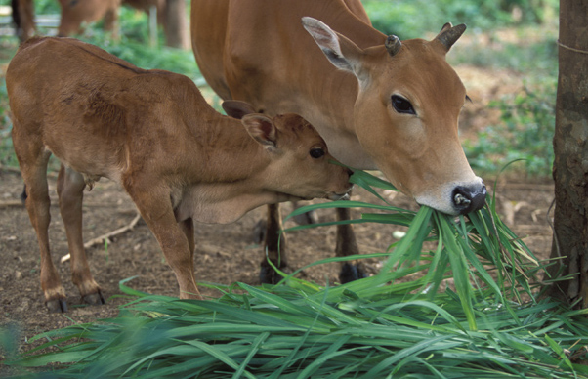
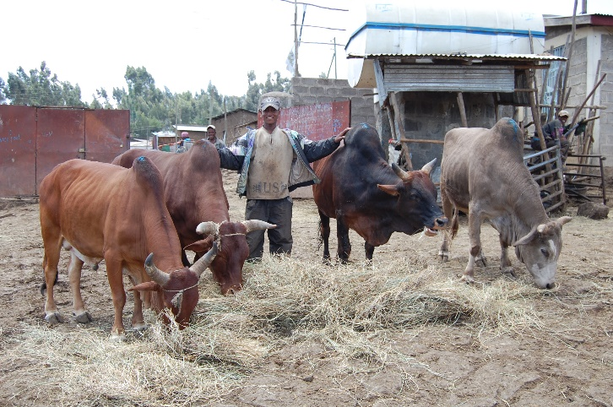
Why is this useful?
Stimulating adoption of better feed options at scale could transform livestock productivity and hence livelihoods and human nutrition outcomes
Maps act as talking points for national and regional prioritization of livestock feed development efforts by Ministries, NGOs, donors and private sector

